Slide 1
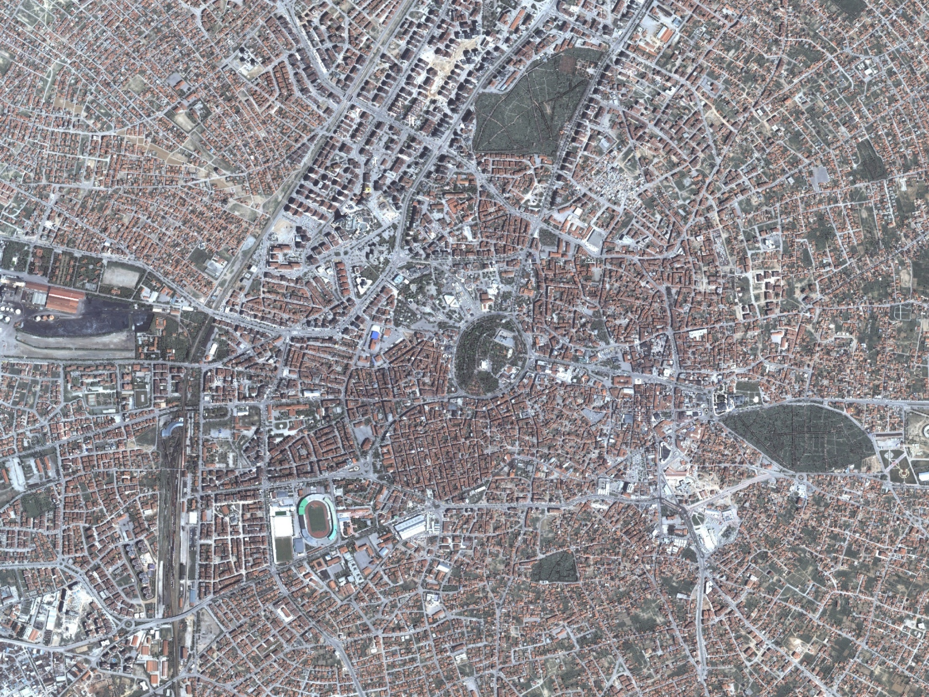

KONYA
GEOGRAPHIC
INFORMATION
SYSTEM
Konya Metropolitan Municipality Department of Housing and Urban Development

Slide 2
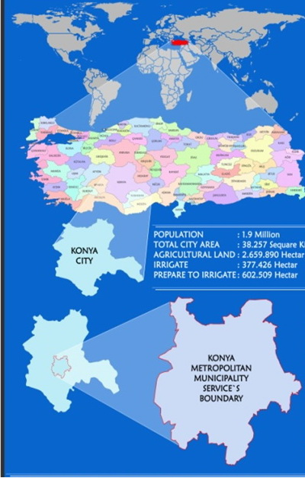
Konya municipality RESPONSIBILITY AREA: 2,060 km2 (up to 2014 )
Konya metropolitan municipality border population: 1,107,886
District population centers: 1.563.863
Town rural population: 488,418
City general population: 2,052,281
Street number: 26827
City TOTAL AREA: 40,814 km²
City TOTAL NUMBER OF DOORS: 364171
City TOTAL NUMBER OF HOUSES: 545558

Slide 3
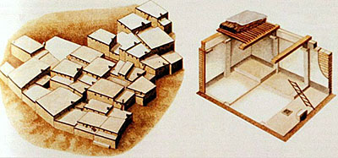
M.Ö. 7000 ÇatalHüyük-The first residential area of humans
İkonion>ikonyum>Kuuniye>”KONYA”

Slide 4
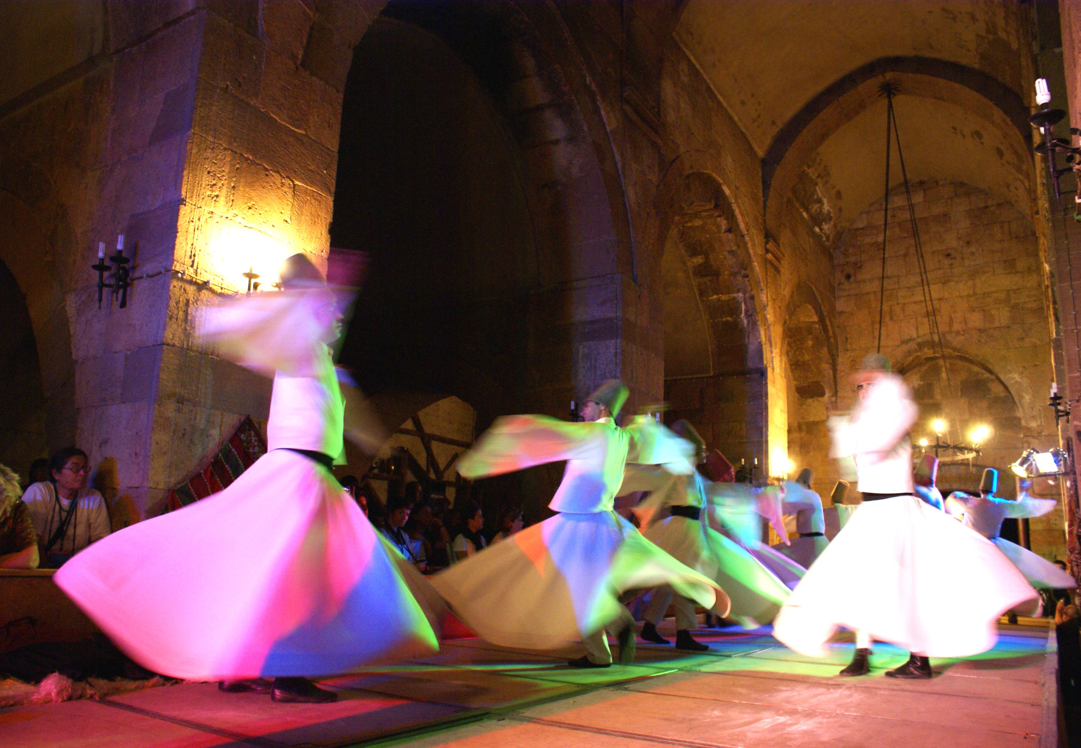

Slide 5


Slide 6
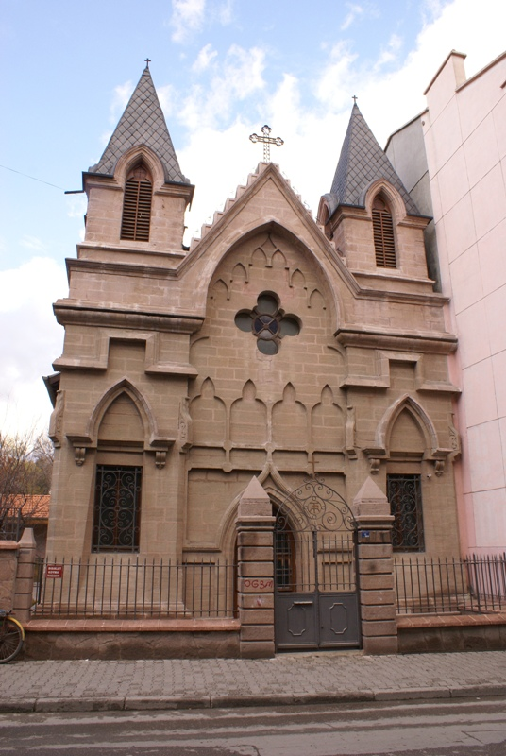
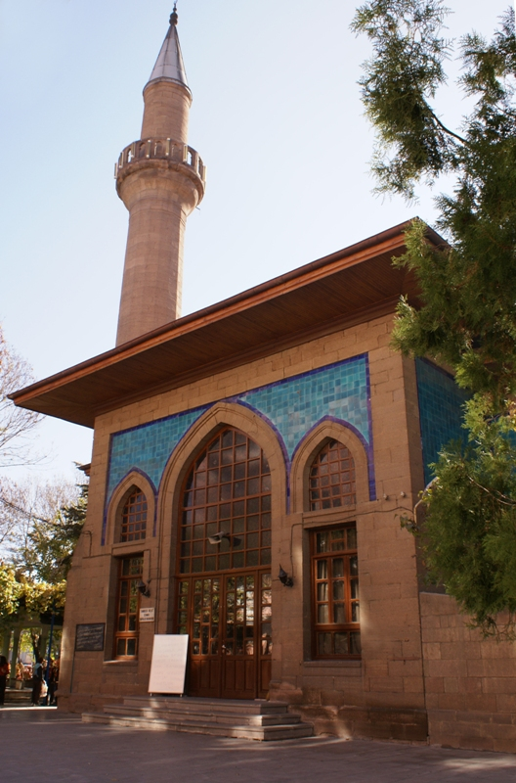
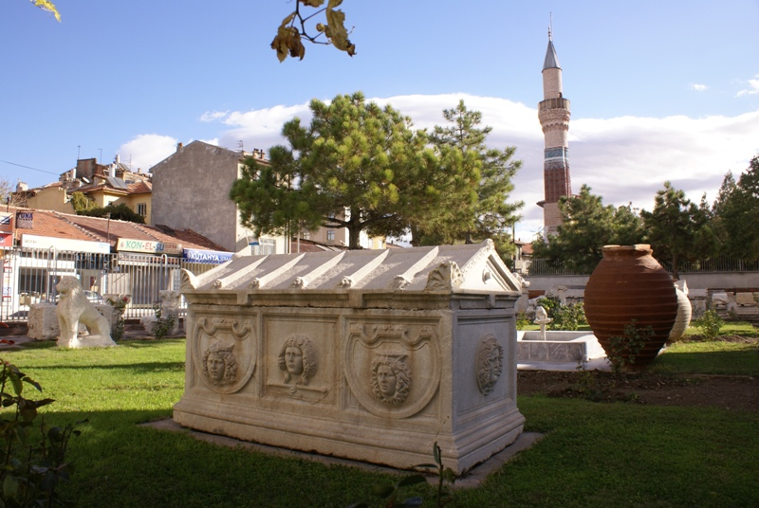

Slide 7
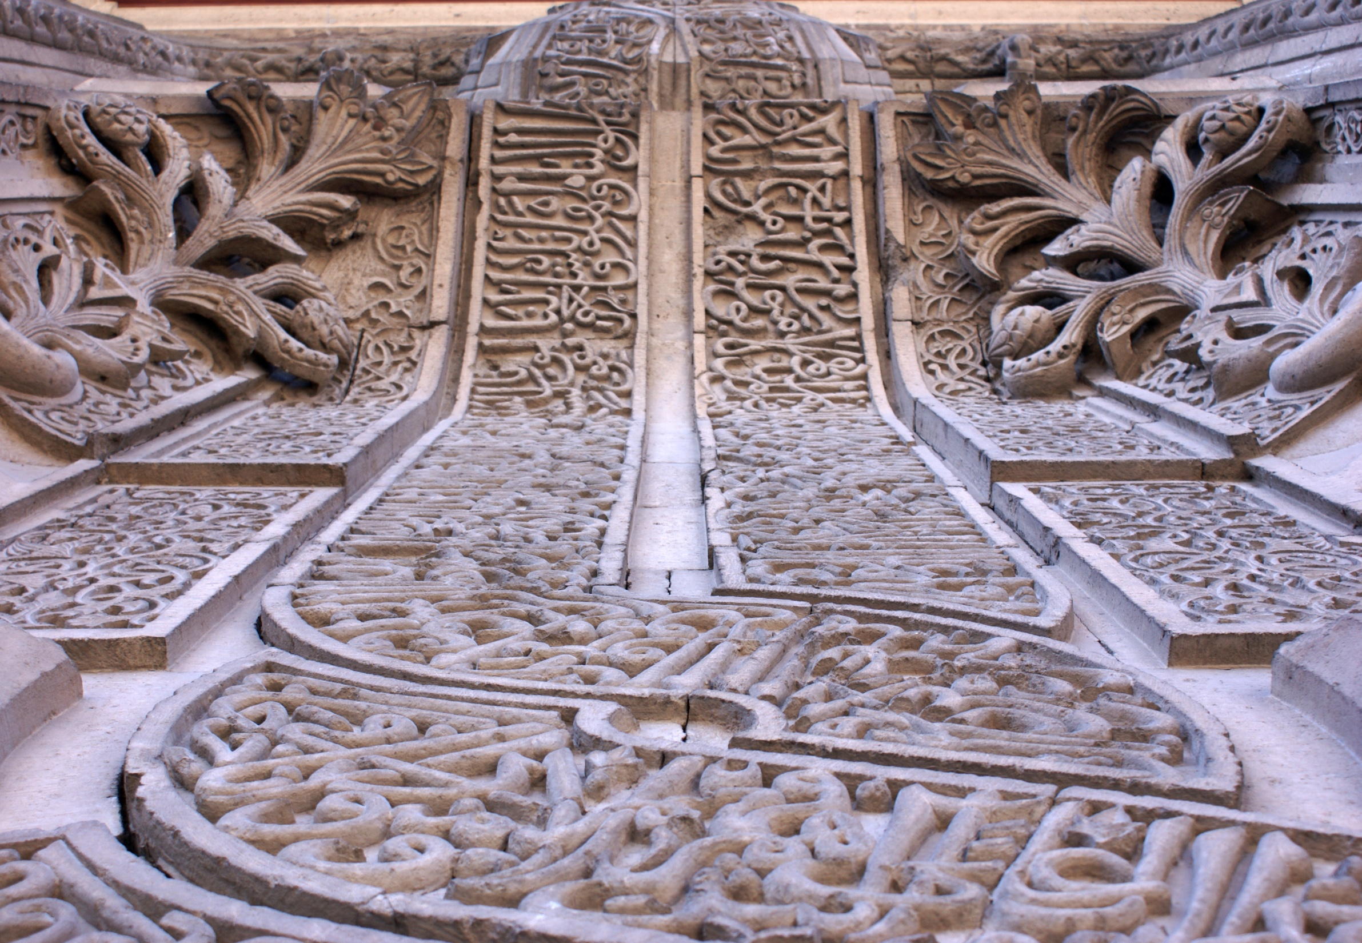

Slide 8
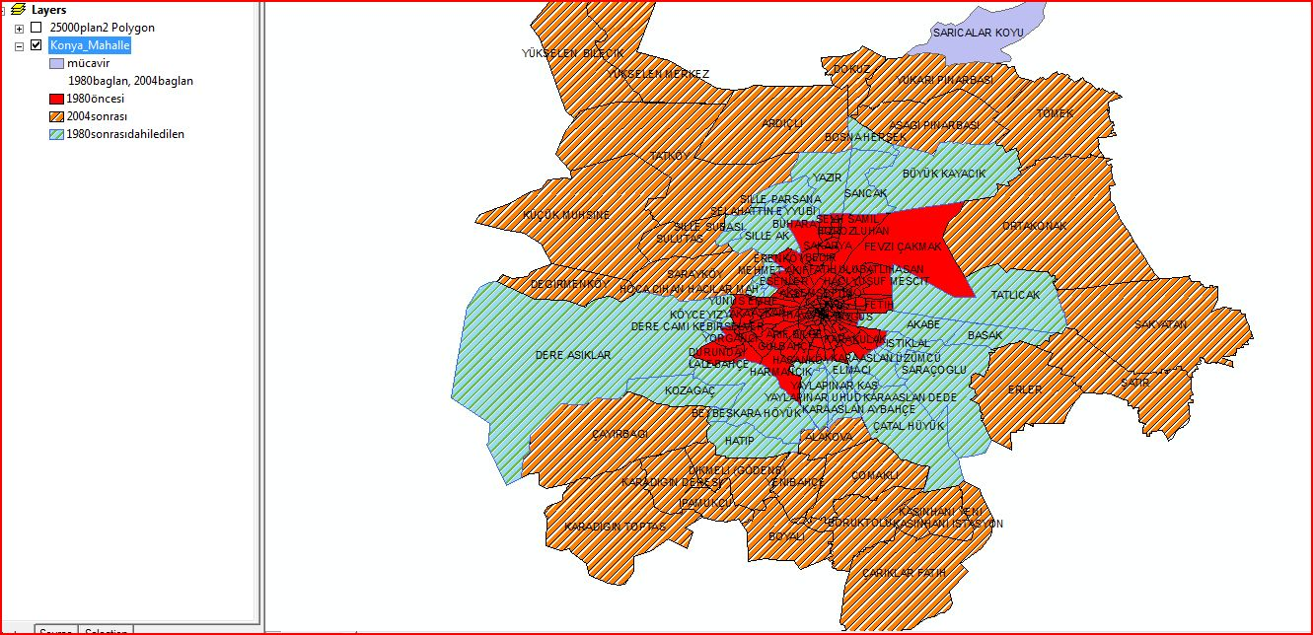
1946
1954
1967
1983
1999

Slide 9
Population Development of Konya City Center

Slide 10
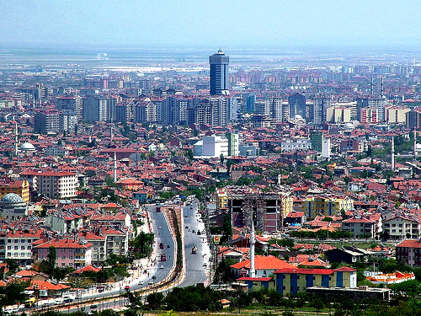
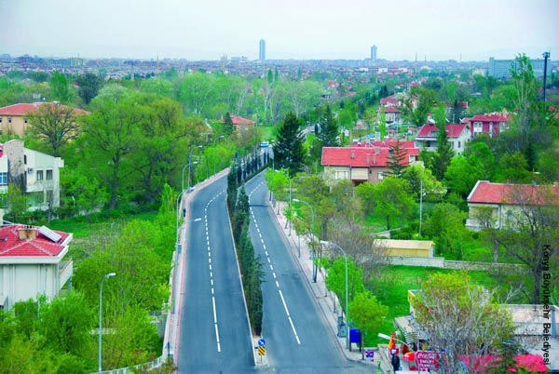
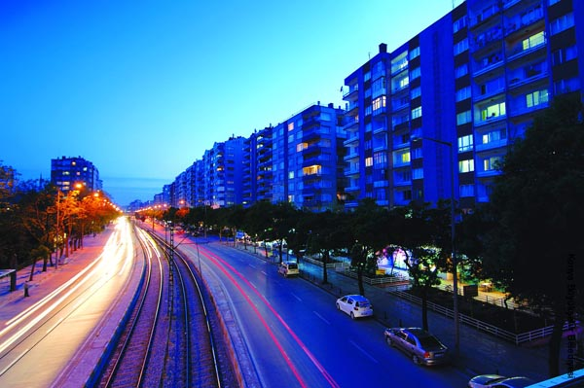
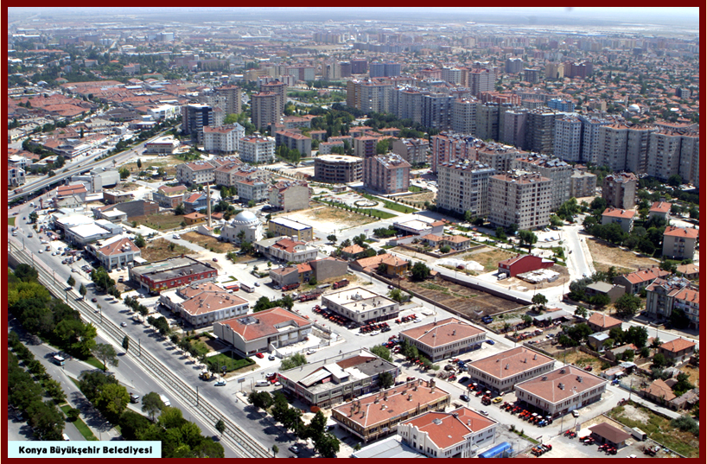
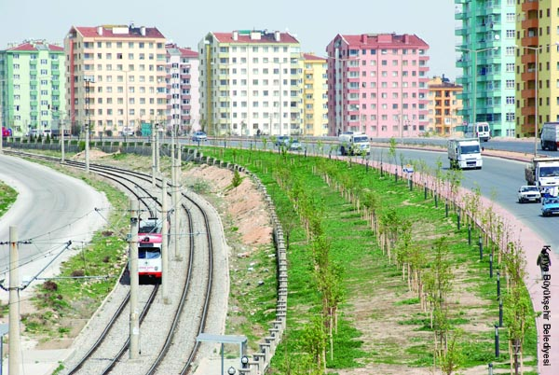
Konya is the best planing process city of Turkey
Planning started in 1947
City Administrator to remain faitful to planining aim
İllegal Housing minimal level…(ithas got 72 slums ..now)
Citizens were encouraged to organize cooperatives (especially 1970-1994 years) for prevention slums and illegal hausing
The Amount of the internal Migration and external migration is balanced
Konya people dosent attempt to lands of the public

Slide 11
THE NEW MAIN IDEA is
Supporting Sustainable Planing and Development of KONYA
We need to new management methots

Slide 12

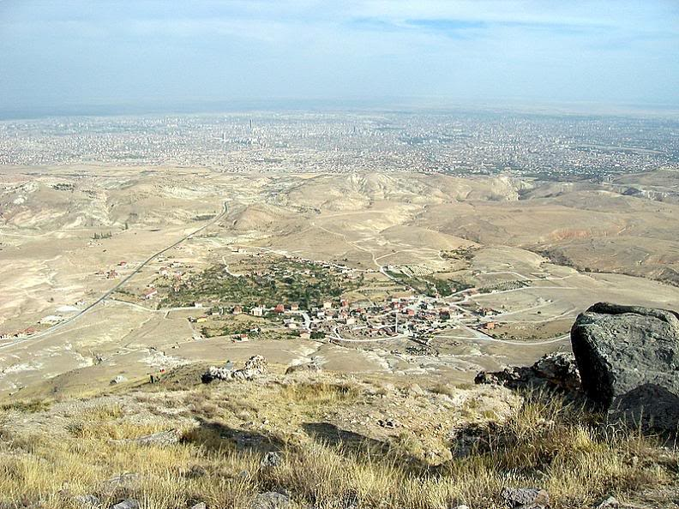


KONYA METROPOLITAN MUNICIPALITY’S RESPONSIBILTY AREA IS 2100 km²

Slide 13
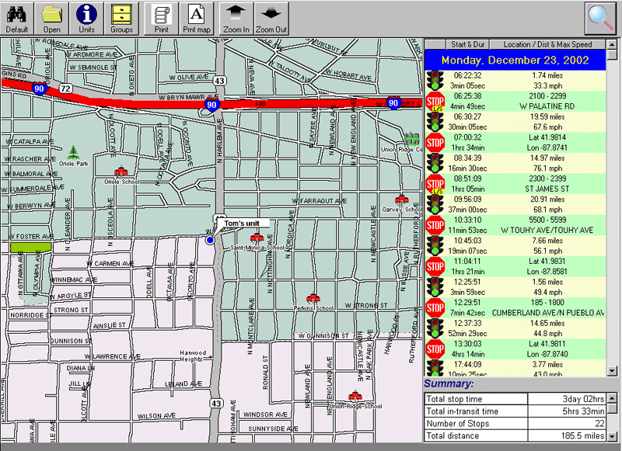
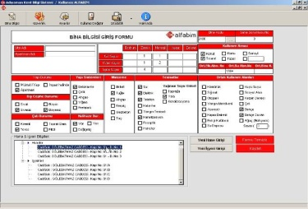
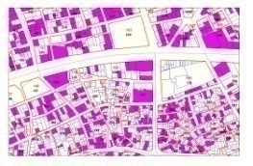
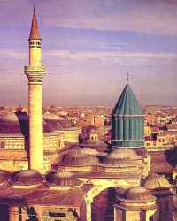
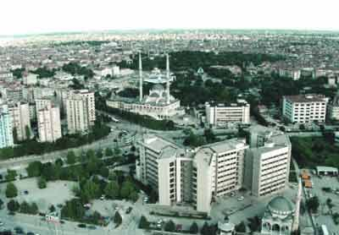

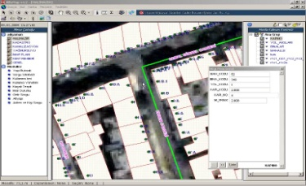
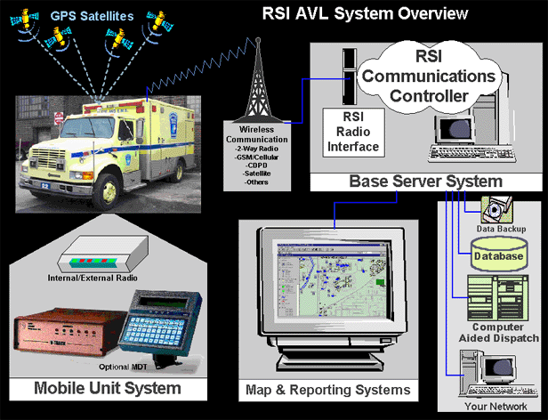
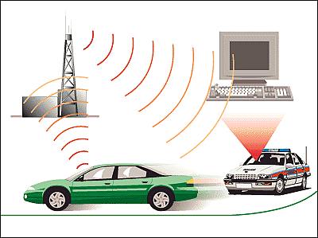
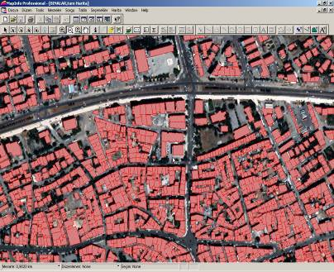
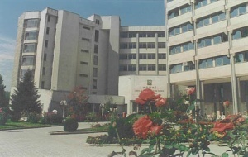
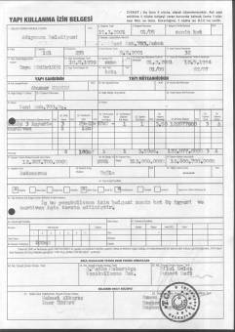
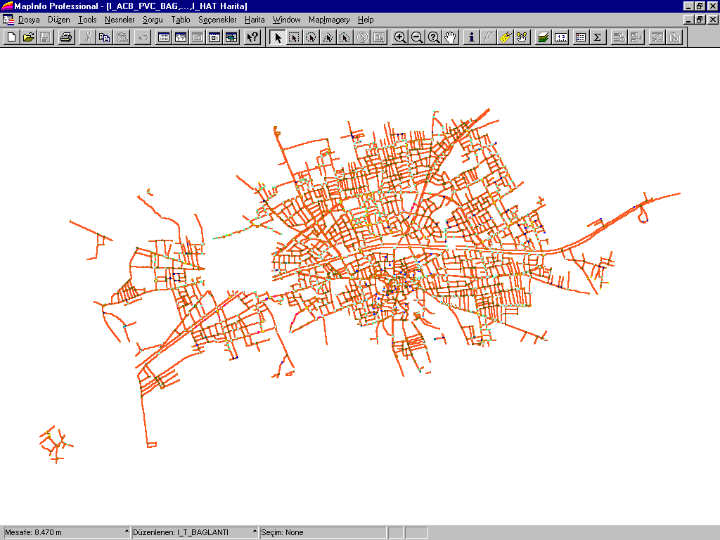
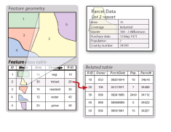
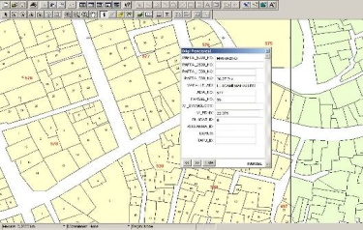
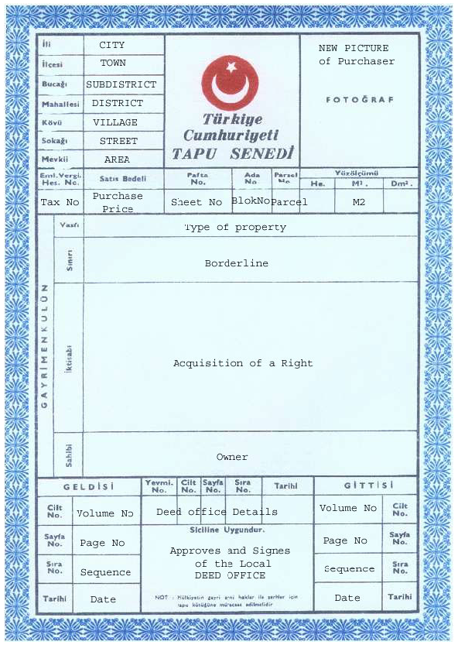
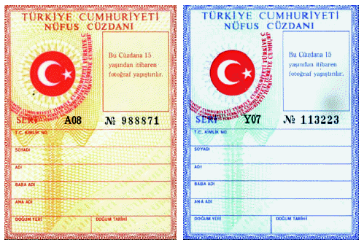
WHY DO WE NEED GIS FOR KONYA ?
ALL DATAS AND GOVERNMENTAL DATAS
2050 YEAR’S
GEOGRAPHIC INFORMATION SYSTEM (GIS)
2030 YEAR’S
Purpose
GOVERNMENTAL DECISIONS
2020 YEAR’S
PRESENT TIME
how will be the future KONYA ?
GO TO STRATEGICAL PLANNING

Slide 14
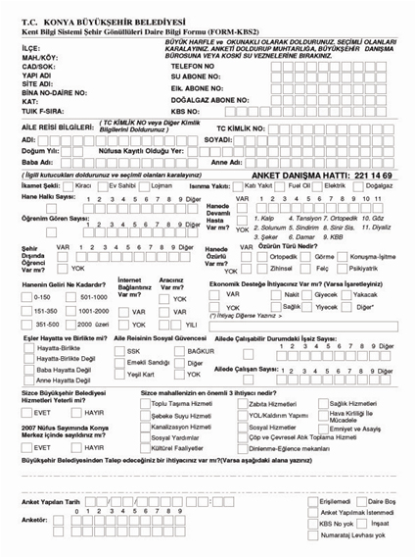


WHAT IS THE GIS FOR KONYA?
INTELLIGENT DECISIONS BASE WITH GIS
URBAN SERVICES
CITY PLANING
URBAN SERVICES
URBAN FACILITIES
City Plans
Parcels
Address
Parcel’s Owner
URBAN SERVICES
SUBSTRUCTION PLANING
Citizen’s Information
etc.
URBAN SERVICES
CITIZEN ACTIVITIES
Citizen’s Survey
URBAN SERVICES
TRANSPORTATION PLANING (PUB&PRIV)
URBAN SERVICES
TRANSPORTATION PLANING
KONYA
GIS
URBAN SERVICES
AID ACTIVITIES
URBAN SERVICES
ENVIRONMENT QUALITIES

Slide 15
WHAT IS THE BASE STRUCTURE?
BASE OF KONYA’S GIS HAS 4 PHASES
PHASE 1
PHASE 2
SOCIAL INFORMATION CENTER AND SOCIAL STRUCTURE MAP
POPULATION BASED ADDRESS REGISTRATION SYSTEM CONNECTED THE GIS
INFRASTRUCTER COORDINATION CENTER
TAKBIS-PARCEL & PARCEL’S OWNER INFORMATION
BASE OF KONYA’S GIS
PHASE 3
PHASE 4

Slide 16
HOW IS THE KONYA GIS’S ARCHITECTUREL WORKFLOWS ?
TAKBIS
WITH GOVERNMENTAL PROTOCOL’S AND AUTHORIZATION
ADDRESS
GEOGRAPHIC
INFORMATION SYSTEM
(GIS)
ADNKS
URBAN INFRASTRUCTURE
WITH GOVERNMENTAL PROTOCOL’S AND AUTHORIZATION
DATA OF SOCIAL AID
GENERAL ARCHITECTURE OF GIS
WEB SERVICES BASE INTERNET
OTHER UIS MODULS
WITH AUTHORIZATION
WEB SERVICES BASE INTERNET
THIS SCHEMA PRESENT TO GENERAL ARCHITECTURE OF UIS AND RELATIONAL TITLE
WE WERE PREPARED A RELATIONAL DATABASE AND SOFTWARE STRUCTURE ACCORDING TO WORKFLOW AND GENERAL ARCHITECTURE OF GIS

Slide 17
WHAT IS THE BASEMAP & BASE INFORMATION?

Slide 18
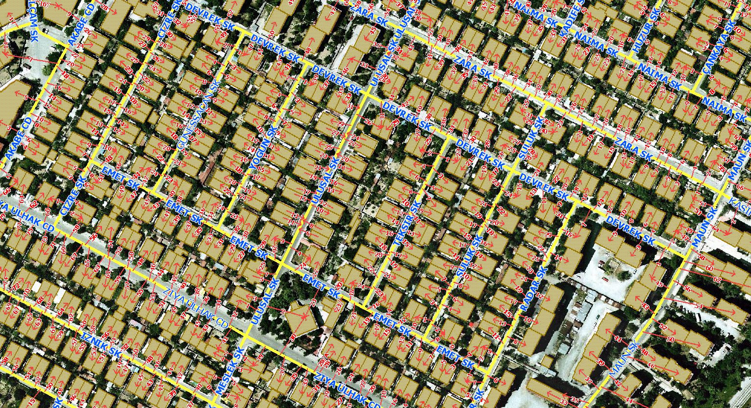
WHAT IS THE BASEMAP & BASE INFORMATION?
MAP OF BUILDING NUMERATE
NUMERATE PRODUCED FOR BUILDINGS ON THE LAND

Slide 19
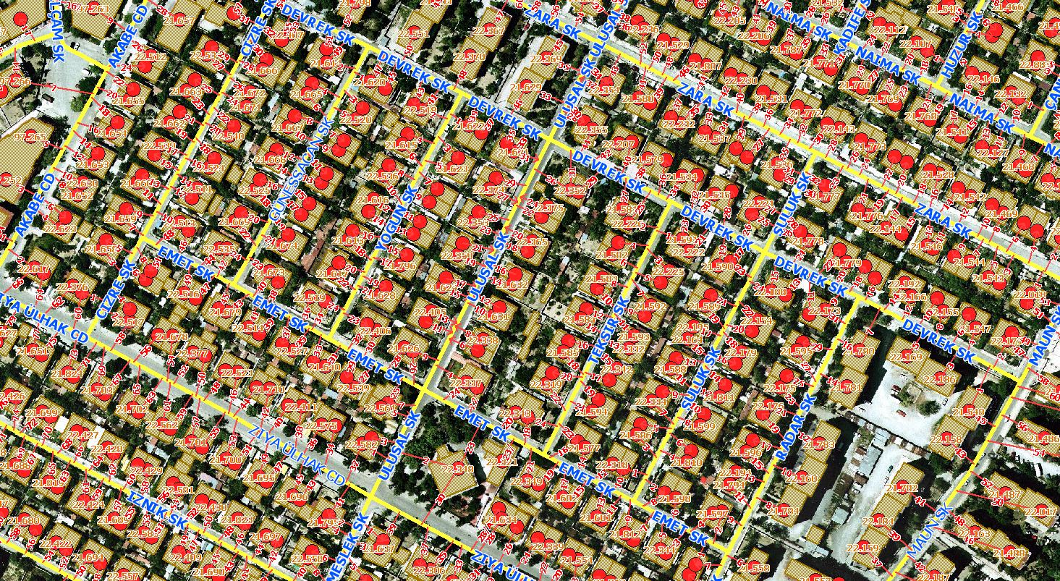
WHAT IS THE BASEMAP & BASE INFORMATION?
MAP OF BUILDING IDENTIFICATION
IDENTIFICATION NUMBER WAS GIVEN TO ALL BUILDINGS

Slide 20
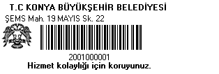
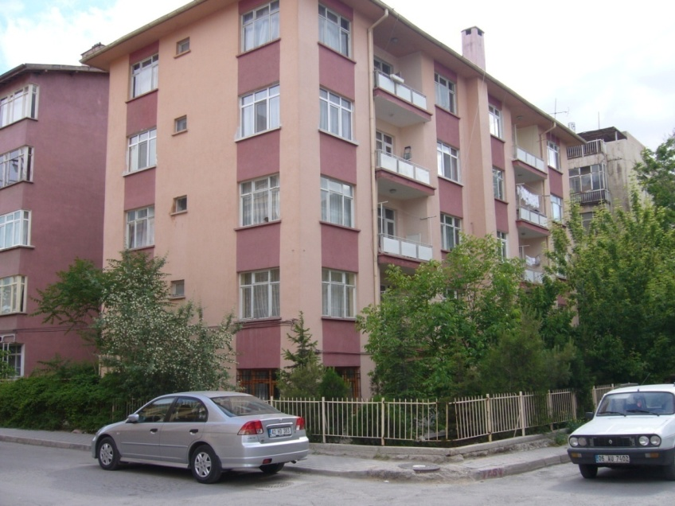
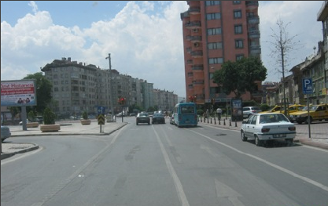
WHAT IS THE BASEMAP & BASE INFORMATION?
GIS BARCODING
PHOTOGRAPHS WERE TAKEN FOR ALL STREETS
PHOTOGRAPHS WERE TAKEN FOR ALL BUILDINGS
PHOTOGRAPHS WERE TAKEN FOR ALL STREETS AND BUILDINGS
BARCODES WERE APPLIED FOR ALL BUILDINGS

Slide 21
WHAT ARE CREATING SPATIAL ANALYSIS FOR CITY MANAGEMENT?

Slide 22
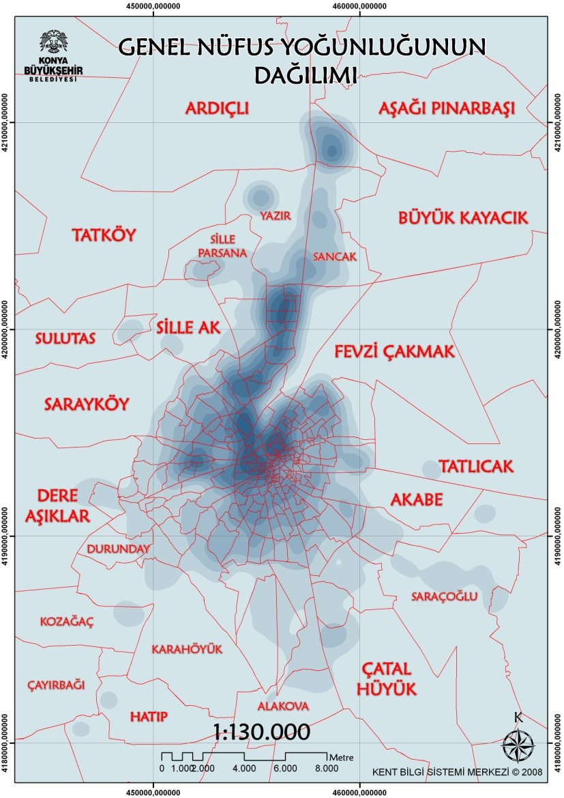
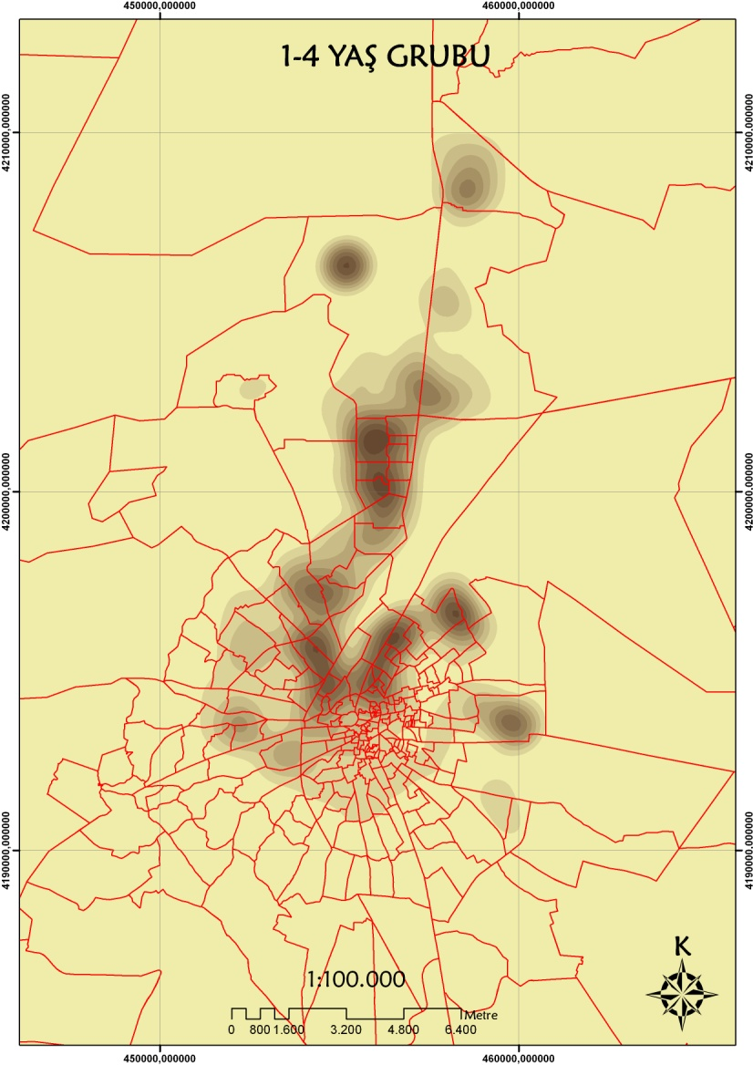
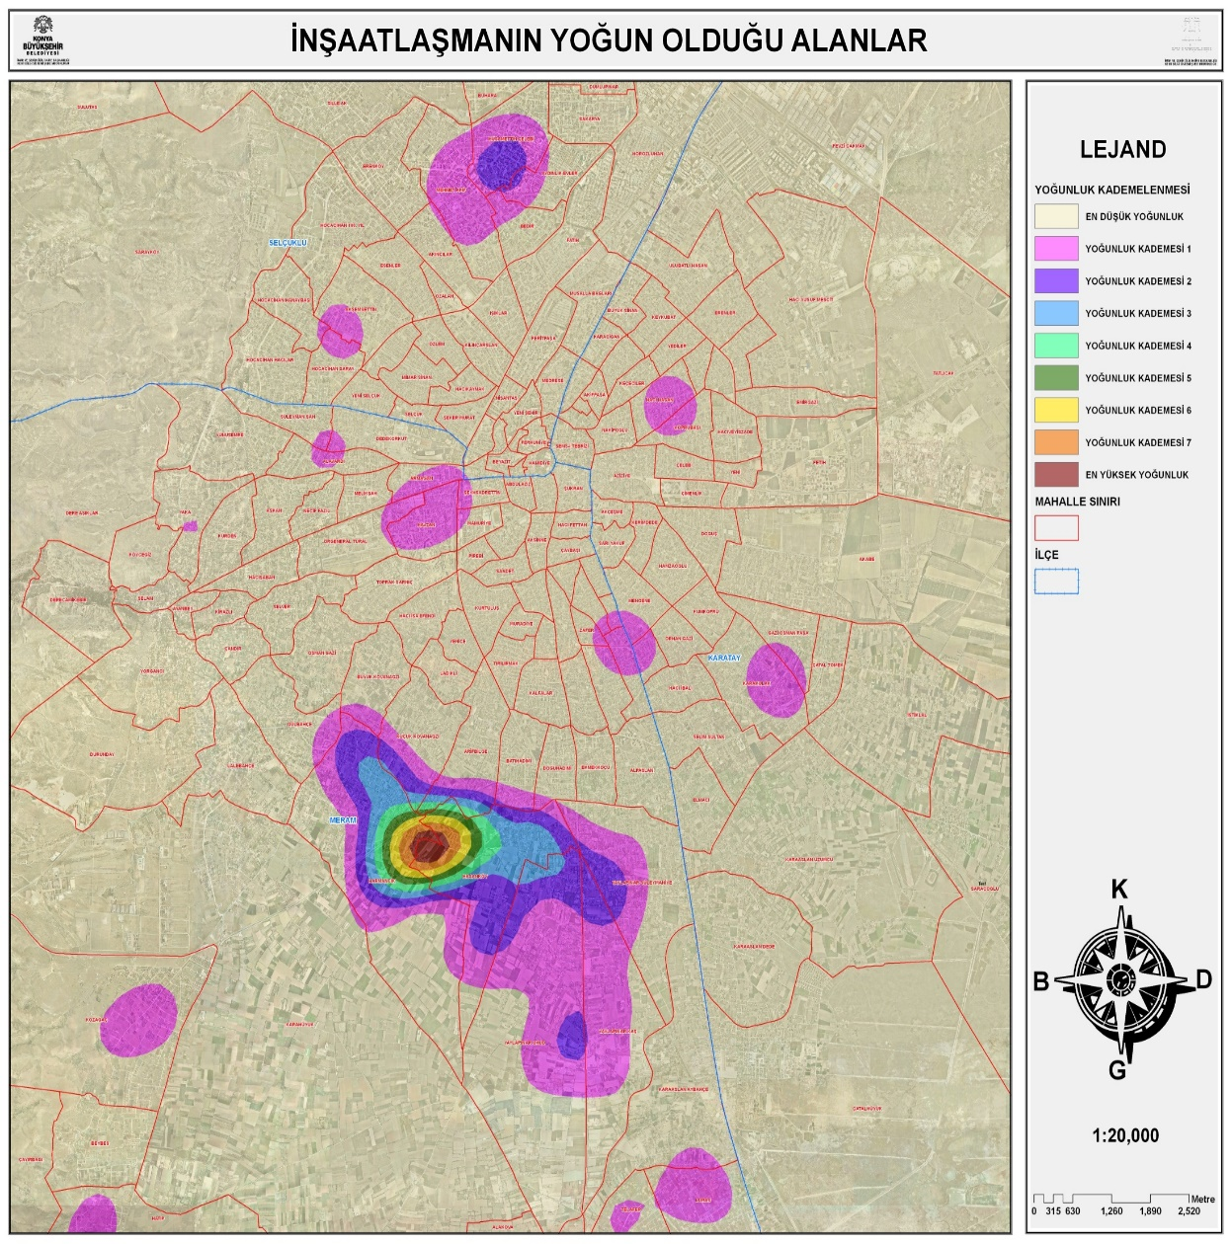
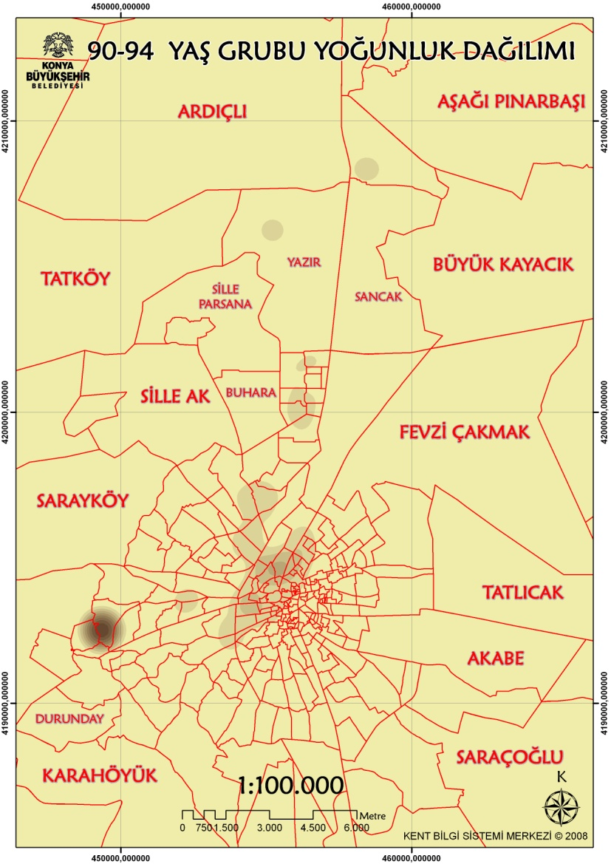
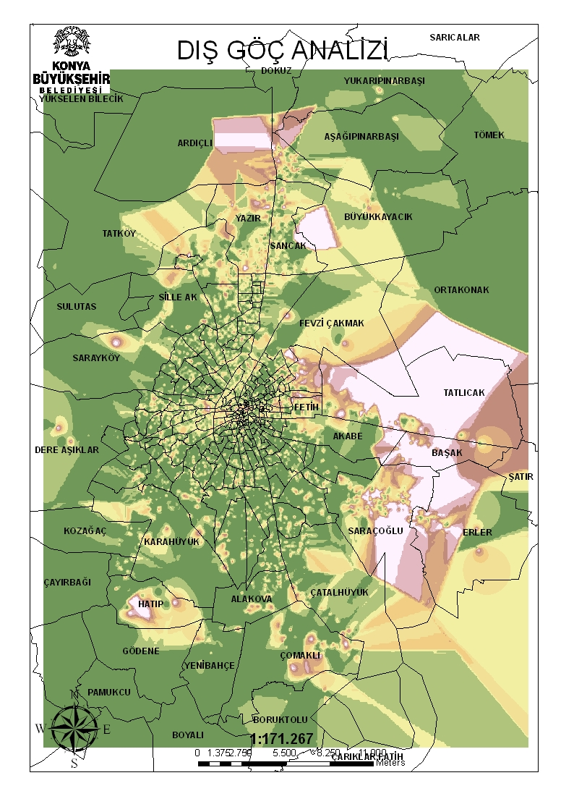
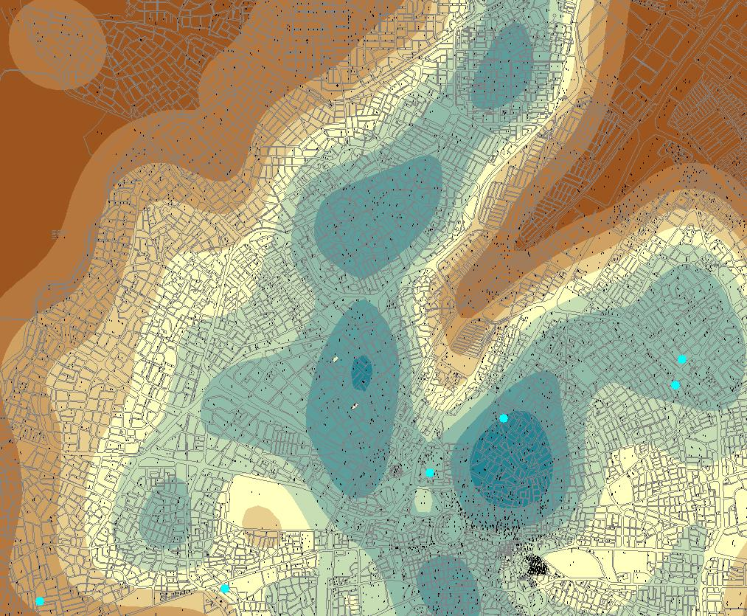
WHAT ARE CREATING SPATIAL ANALYSIS FOR CITY MANAGEMENT?
DISTRIBUTION OF KINDERGARTEN AND INTERSECT WITH 1-5 AGE GROUP
TRACKING DENSITY OF STRUCTURING IN THE CITY
DENSITY OF EXTERNAL MIGRATION
DENSITY OF GENERAL POPULATION
DENSITY OF 1-4 AGE GROUP
DENSITY OF 90-94 AGE GROUP
WE CREATED POPULATION DENSITY ANALYS ACCORDING TO SETTLEMENT POPULATION ALSO CREATED AGE GROUPS DENSITY ANALYSES ON THE CITY. WE INTERSECT AGE GROUP ANALYSIS WITH URBAN USES AREAS. EXAMPLE; 1-5 AGE GROUP WITH KINDERGARTEN AFTER WE ARE RESEARCHING PLANING SUFFICIENCY IN THE CITY PLAN’S

Slide 23
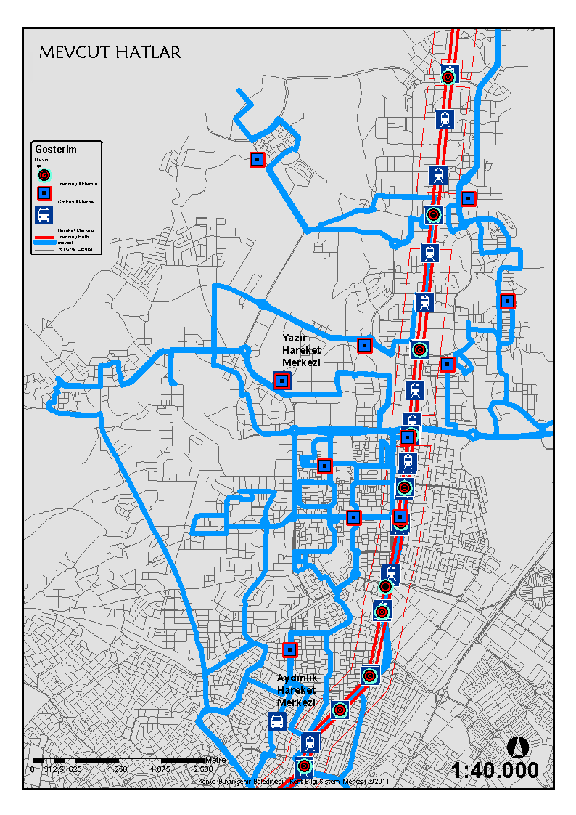
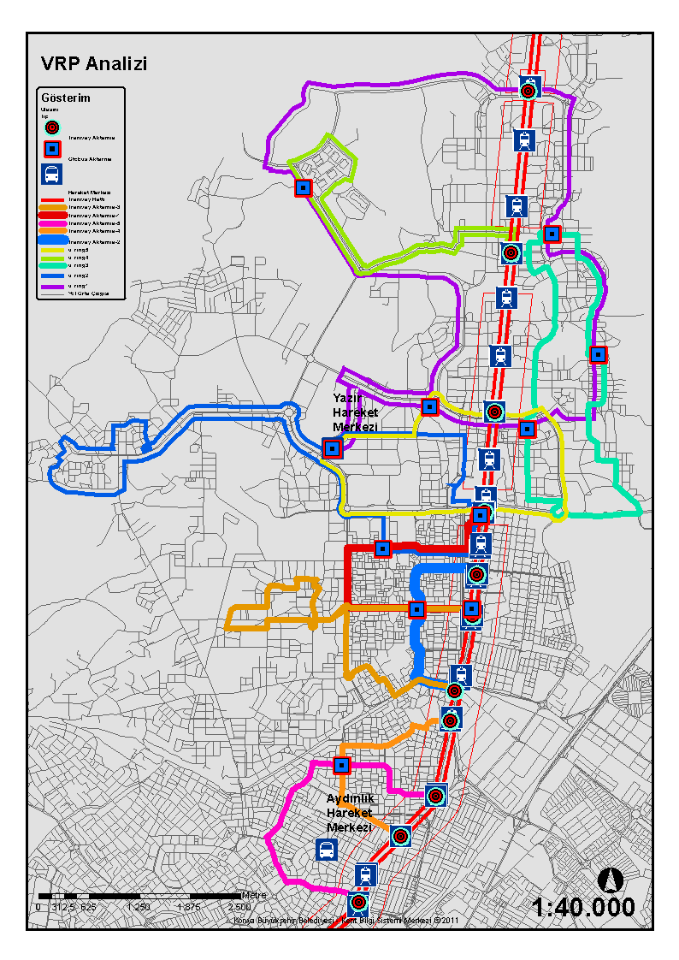
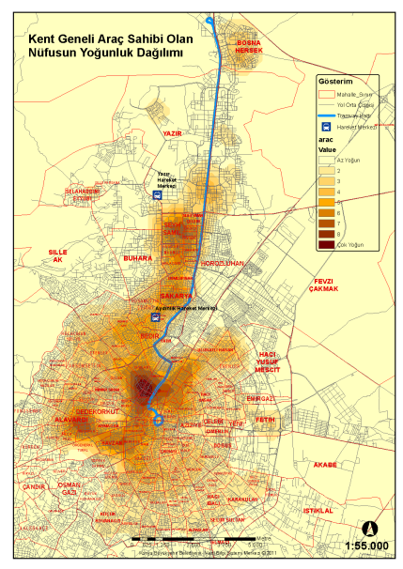
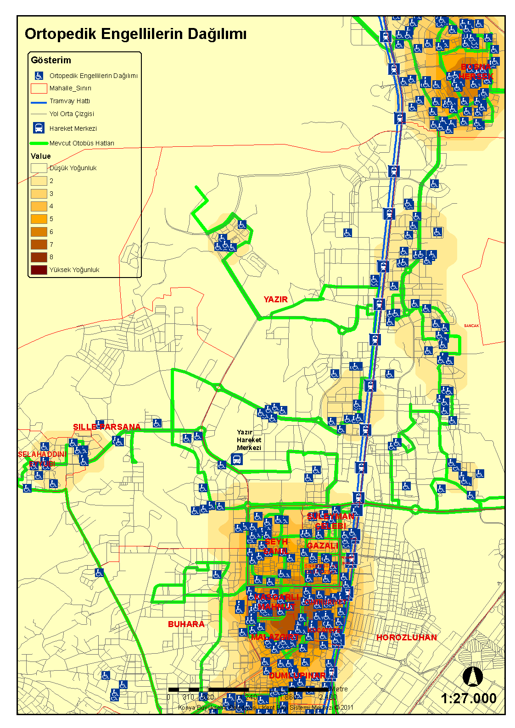
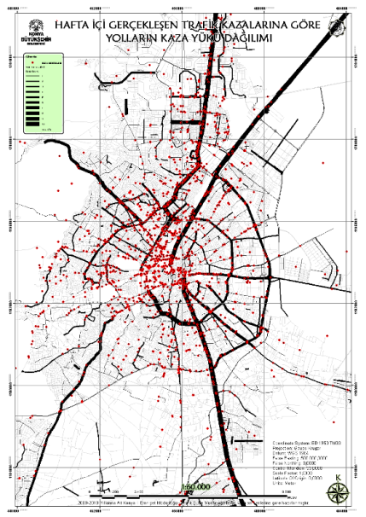
WHICH DO WE CREATE ANALYSIS FOR METROPOLITAN MUNICIPALITY ?
FOR PUBLIC TRANSPORTATION
DENSITY OF VEHICLE
DENSITY OF HANDICAPPED
DISTRIBUTION OF TRAFFIC ACCIDENT
BEFORE BASE ON GIS PLANING
AFTER BASE ON GIS PLANING

Slide 24
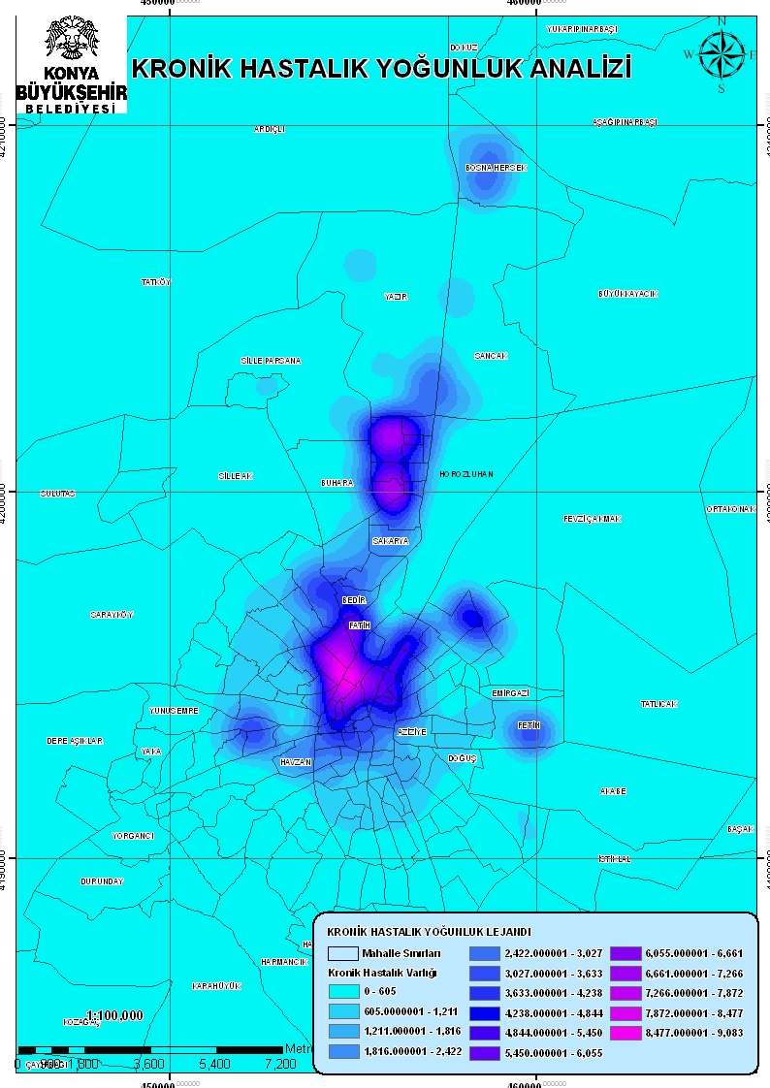
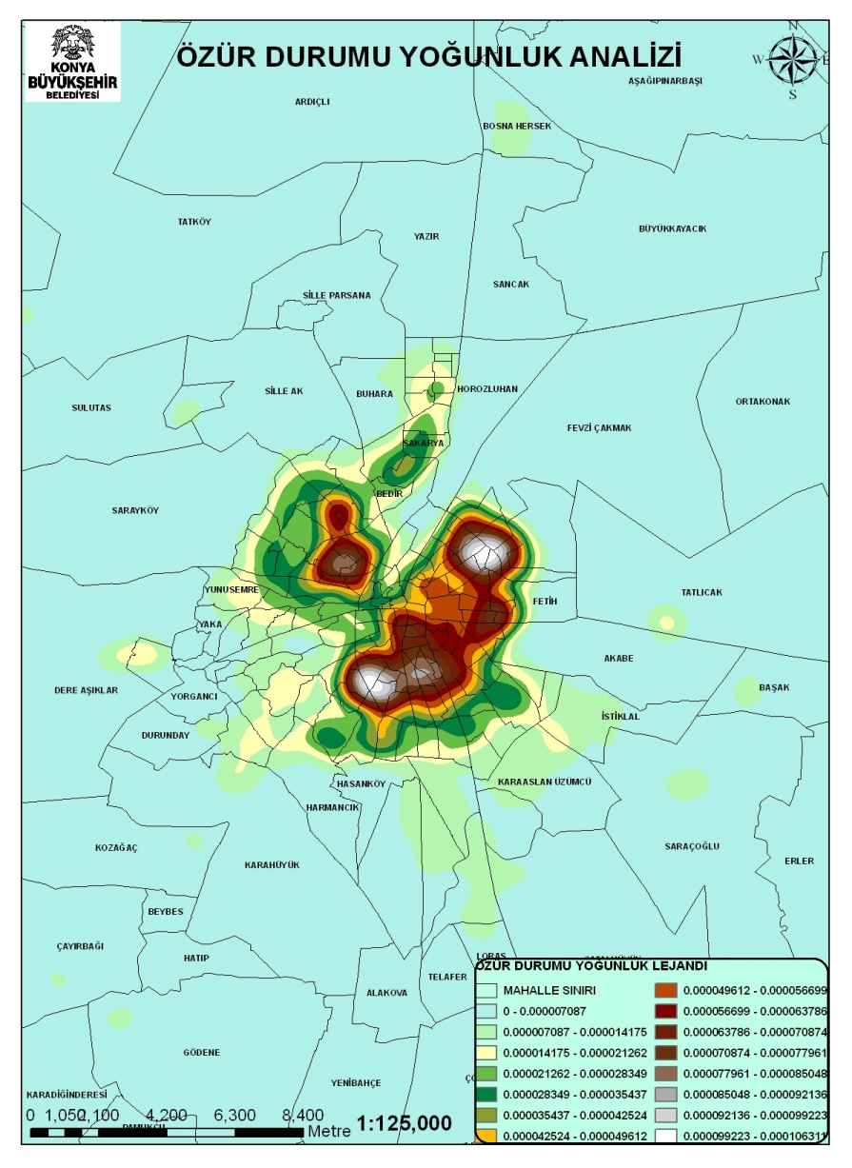






WHICH DO WE CREATE ANALYSIS FOR METROPOLITAN MUNICIPALITY ?
SOCIAL FABRIC ANALYSIS
WHERE IS THE CRONICAL PATIENT DENSITY’S INCREASE?
WHERE IS THE HANDICAPPED PATIENT DENSITY’S INCREASE?
WHERE IS THE DIALYSIS PATIENT DENSITY’S INCREASE?
WHERE IS THE HEART PATIENT DENSITY’S INCREASE?
WHICH HOMES HAS MAXIMUM SALARY AND MINIMUM SALARY?
WHICH FOUNDATION AND ASSOCIATION DISTRIBUTE AID ON GEOGRAPHY?
WHICH HOMES HAS NEEDS PERSON AND HANDICAPPED PERSON?
THIS PICTURES ARE INTERESTED WITH DIFFERENT SOCIAL FABRIC ANALYSIS ON THE CITY

Slide 25


WHICH DO WE CREATE ANALYSIS FOR METROPOLITAN MUNICIPALITY ?
DETECTIVE POINT OF TARGET FOR POOR PERSON FROM GIS HYBRID ANALYSIS
DENSITY OF UNEMPLOYED DISTRIBUTION

Slide 26


WHICH GIS DATA DO WE COLLECT ?
CITY PLAN
MAP SCALE: 1/1.000
MASTER PLAN
MAP SCALE: 1/50.000
CITY PLAN AND MASTER PLAN WERE COLLECTED FROM METROPOLITAN MUNICIPALITY AND DISTRICT MUNICIPALITIES
CONVERSION CAD TO GIS FILE SYSTEM WITH TOPOLOGY
ENTEGRATED THIS DATA IN TO GIS

Slide 28




WHICH GIS DATA DO WE COLLECT ?
CANALIZATION LINE FROM COMPANY OF WATER AND SEWER
WATER LINE FROM COMPANY OF WATER AND SEWER
ELECTRICITY LINE FROM COMPANY OF ELECTRICITY
GAS LINE FROM COMPANY OF GAS
UTILITIES NETWORK MAPS WERE COLLECTED FROM UTILITIES COMPANIES
CREATED BASE MAP WITH SAME COORDINATE FROM COLLECTED DATA AFTER THE DATA PROCESSED
THIS DATA WAS INTEGRATED IN TO GIS

Slide 29


WHICH WORKFLOW DO WE DETERMINE FOR GIS ?
FIRST TIME e-SIGN&GIS BASED
UTILITIES PROJECTS WORKFLOW
EXCAVATION PROJECTS
APPROVAL
MECHANISM
INFRASTRUCTURE COMPANIES
E-SIGN– 1A
E-SIGN– 1B
TRAFFIC
SIGNALIZATION
KBB ROAD BUREAU
E-SIGN – 3
AYKOME
KARATAY ROAD BUREAU
IF NOT PROVIDE OR COMING TO PROVIDE
PROVIDE
MERAM ROAD BUREAU
CHIEF
E-SIGN– 2
ESIGN– 5
SELÇUKLU ROAD BUREAU
MANAGER
ESIGN– 6
HEAD OF UTI. & CONS. DEPART.
EXCAVATION CERTIFICATE
TELEKOM
ELECTRICITY
WATER
GAS
ESIGN– 7
MAYOR
APPROVE
ESIGN– 4
ESIGN– 4
ESIGN– 4
ESIGN– 4
ESIGN– 8
THIS SCHEMA IS WORKFLOW FOR UTILITIES, THIS WORKFLOW USED AFTER UIS, WE ONLY INTEGRATED PRESENT SITUATION FOR UTILITIES IN TO GIS WITH E-SIGN, THIS SIGN APPROVED “THE SCIENTIFIC AND TECHNOLOGICAL RESEARCH COUNCIL”-TUBITAK. INFRASTRUCTURE COMPANIES SHARING DATA WITH “DATA SHARING PROTOCOLS”

Slide 30

WHICH UIS DATA DO WE COLLECT ?
QUESTIONNAIRE GENERAL CONTENTS
DEMOGRAPHY,
HEALTLY,
ECONOMY,
MUNICIPALITY SERVICES,
SETTLEMENT INFORMATION,
SOCIAL AID SITUATION
QUESTIONNAIRE DETAILS CONTENTS FOR SOME QUESTIONS
HOW MANY PEOPLE LIVE IN YOUR HOME?
HOW MANY PEOPLE GO TO EDUCATION IN YOUR HOME?
HOW MUCH IS YOUR FAMILY’S MONTHLY SALARY?
ARE THERE ANY HANDICAPPED IN YOUR HOME?
IF ANSWER IS YES THEN WHAT IS THE HANDICAPPED CATEGORY?
DO YOU LIKE METROPOLITAN MUNICIPALITY SERVICES?
DO YOU NEED ANYTHING? (MONEY, COAL, FOOD, STATIONERY, etc.)
HOW MANY PEOPLE WORKING IN A JOB IN YOUR HOME?
ARE THERE ANY CHRONIC ILLNESS IN YOUR HOME?
IF ANSWER IS YES THEN WHAT IS THE CHRONIC ILLNESS CATEGORY?
GIS QUESTIONNAIRE FORM
WE WERE COLLECTED SOCIAL QUESTIONNAIRE ALL DWELLING FOR CITIZEN’S SOCIAL STATE AND DEMOGRAPHICAL INFORMATION BY GIS ADDRESS BARCODE

Slide 31

SAMPLE RELATIONAL MODEL FOR QUESTIONNIRE
GEO BARCODE
BUILDING
ADDRESS PLANE
NATIONAL
IDENTIFICATION CARD
GIS QUESTIONNAIRE
WE WERE COLLECTED SOCIAL QUESTIONNAIRE ALL DWELLING FOR CITIZEN’S SOCIAL STATE AND DEMOGRAPHICAL INFORMATION BY GIS ADDRESS BARCODE

Slide 32
WHICH UIS DATA DO WE COLLECT ?
GIS BASED DISTRIBUTION OF DONATION
NEEDY PERSON APPLICATION
APPLICATION PHASES
GOVERNORSHIP OF KONYA
DISTRICT GOVERNORSHIP
METROPOLITAN MUNICIPALITY
LOCAL MUNICIPALITY
FOUNDATIONS & ORGANIZATIONS
DATABASE
DATABASE
DATABASE
DATABASE
DATABASE
DETAIL QUERIES OF NEEDY PERSON’S FOR OTHER ORGANZATIONS
AID TO DONATE
GIS DATABASE
NATIONAL PARCEL OWNER’S SYSTEM
FOR IDENTIFICATION NUMBER QUERIES BY ONLINE
NATIONAL ADDRESS DATABASE
FOR PARCEL OWNER SITUATION BY ONLINE

Slide 33
Our New Projects

Slide 34





NEW GENERATION PROJECT BASE ON GIS
LOD-3
GIS BASED OBLIQUE IMAGERY & 3D CITY MODELLING
PHOTOREALISTIC 3D CITY MODEL
OBLIQUE IMAGERY
PREPARING FOR MOBILE
3D CITY GUIDE ON WEB
PROJECT SITUATION: CONTINUE

Slide 35


NEW GENERATION PROJECT BASE ON GIS

Slide 36

NEW GENERATION PROJECT BASE ON GIS
PHOTO REALISTIC 3D CITY OF KONYA CITY CENTER

Slide 37



NEW GENERATION PROJECT BASE ON GIS
INTELLIGENT ADAPTIVE SIGNALIZATION PROJECT
REAL TIME TRAFFIC SITUATION
REAL TIME SIGNAL SITUATION
SIGNAL SYSTEM RUNNING WITH ARTIFICIAL INTELLIGENCE ACCORDING TO REAL TIME TRAFFIC DENSTIY
AUTOMATICALLY SIGNAL CHANGED FOR ACCREDITED VEHICLES (FIRECAR,POLICE,etc.)
PROJECT SITUATION: CONTINUE

Slide 38


NEW GENERATION PROJECT BASE ON GIS
DIGITAL SIGN BASED ON CITY PLANING PORTAL & PROCESS
PROJECT SITUATION: CONTINUE

Slide 39


NEW GENERATION PROJECT BASE ON GIS
RESCALE GIS BASE FOR NEW RESPONSIBILITY TERRITORY’S
KONYA
20
x
2060 KM²
40814 KM²
RE-SCALE FOR PRESENT GIS
OLD RESPONSIBILITY
AREA
NEW RESPONSIBILITY
AREA
PROJECT SITUATION: CONTINUE

Slide 40

NEW GENERATION PROJECT BASE ON GIS
RESCALE KMM RESPONSIBILITY AREA ACCORDING TO NEW LAW’S
RED BOUNDARY IS NEW RESPOSBILITY AREA OF KONYA METROPOLITAN MUNICIPALITY’S

Slide 41

THANK YOU FOR YOUR PARTICIPATION

