Slide 1
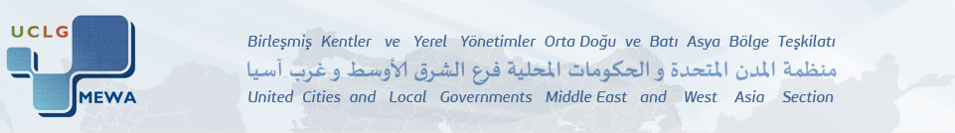
UCLG-MEWA Executive Bureau and Council Joint Meeting, in Konya, Turkey
INNOVATIVE PRACTICES
IN
THE CITY OF IZMIR – TURKEY
PROF.DR. ADNAN O. AKYARLI
DEPUTY CHAIRMAN OF
IZMIR METROPOLITAN CITY COUNCIL &
REPRESANTATIVE OF MR. AZİZ KOCAOĞLU
MAYOR OF IMM & CO-PRESIDENT OF UCLG-MEWA
19-20 DECEMBER 2013

Slide 2
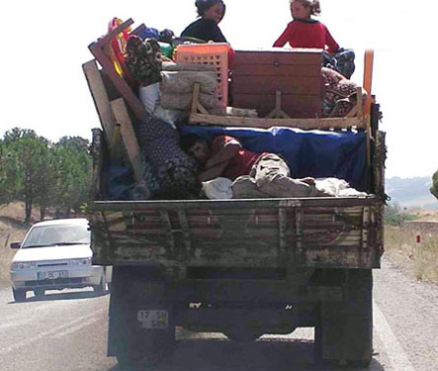
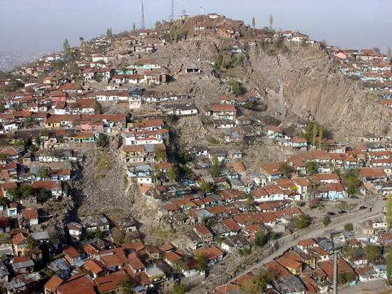
CITY OF IZMIR: A ROLE MODEL IN
INNOVATIVE URBAN TRANSFORMATION
Kentsel Dönüşüm Dairesi Başkanlığı
As it is the case at most of the metropolitan cities, Izmir has also been negatively impacted from the insentive immigration occured during the industrialisation driven urbanisation period.
1970 (1.5 million) & 2013 (4.0 million)
As a consequence of uncontrollable growing, we encountered an increasing population and lack of housing, respectively. The result has been illegal primitive buildings (no legal permission & no technical inspection) and discriminated poor urban regions.

Slide 3
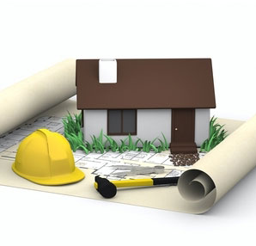
CITY OF IZMIR: A ROLE MODEL IN
INNOVATIVE URBAN TRANSFORMATION
Kentsel Dönüşüm Dairesi Başkanlığı
Since all of the zonning plans are available, local government decided to initiate an «urban transformation process» to creat better living conditions in Izmir.
The main objective of this process is to provide much safer buildings and better social facilities to the citizens as it is foreseen in recent zonning plans.

Slide 4
PRESENT TRANSFORMATION AREAS
Kentsel Dönüşüm Dairesi Başkanlığı
Total transformation area : 4.700 ha ( 47 km2)
First stage (present projects): 410 ha (4.1 km2)
House renewal at first stage : 30.000

Slide 5
OUR INNOVATIVE OBJECTIVES
Kentsel Dönüşüm Dairesi Başkanlığı
On-site transformation,
Protect cultural whealties,
Support social improvement,
Contribute to the peace in the society,
Save historical and cultural heritage

Slide 6

OUR INNOVATIVE PRINCIPLES
Kentsel Dönüşüm Dairesi Başkanlığı
Holostic point of view,
Transparency,
Harmonized interdisciplinary work,
Participatory decision process,
Reinforcement of social and technical infra-structure,
Sustainability

Slide 7
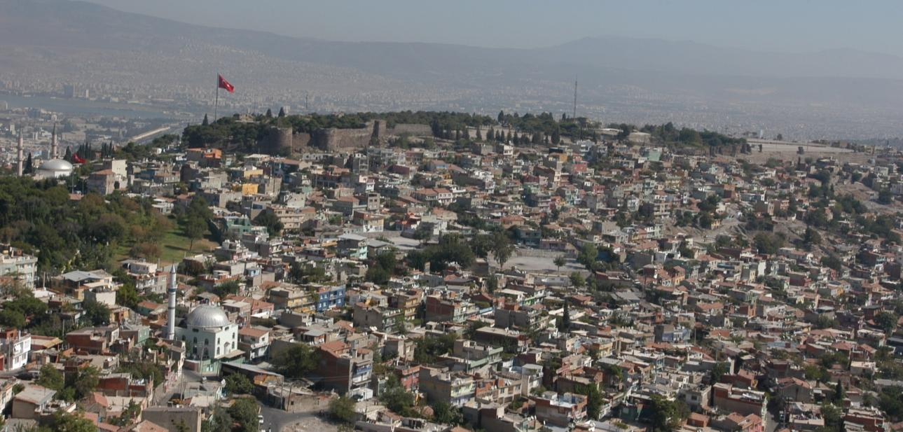
A COMPLETED INNOVATIVE PROJECT: KADIFEKALE
Kentsel Dönüşüm Dairesi Başkanlığı
KADİFEKALE
Objective of the project is to destroy all the houses since Kadifekale is a landslide zone.
Project Area: 42 ha Number of destroyed house: 1968
Impacted population: 20.000 people

Slide 8
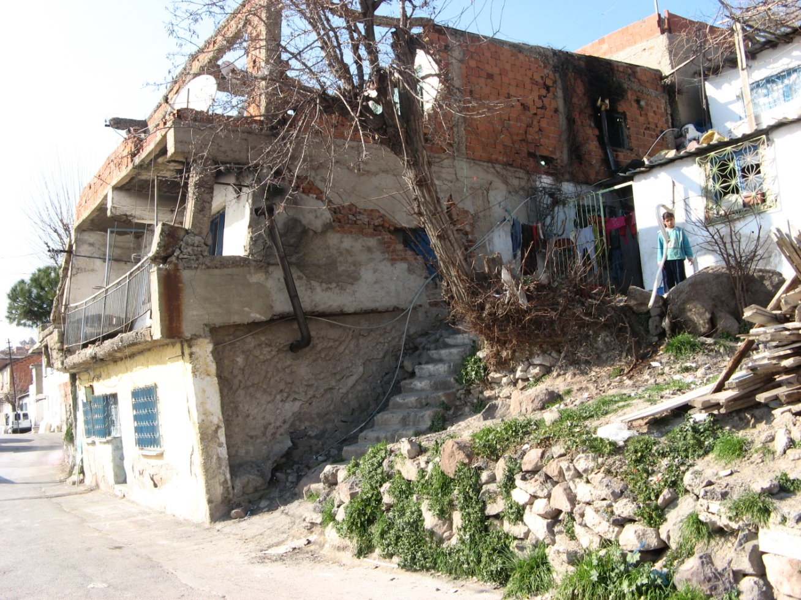
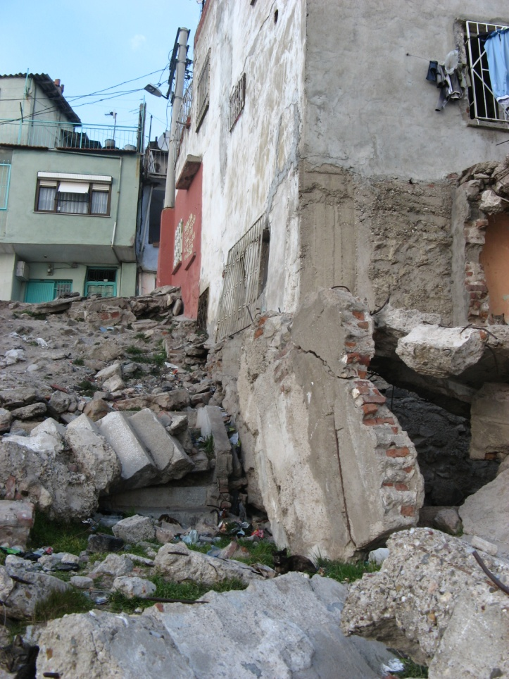
A COMPLETED INNOVATIVE PROJECT: KADIFEKALE
Kentsel Dönüşüm Dairesi Başkanlığı
Sliding houses

Slide 9
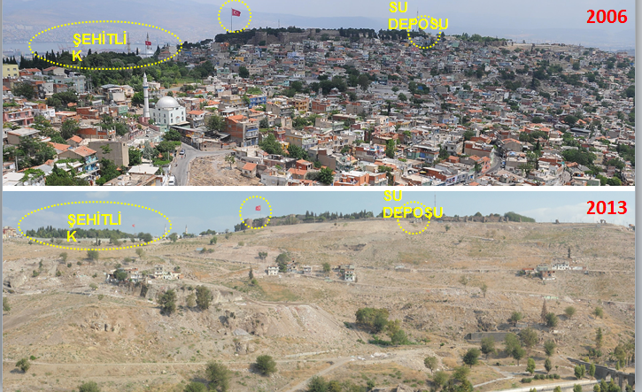
A COMPLETED INNOVATIVE PROJECT: KADIFEKALE

Slide 10
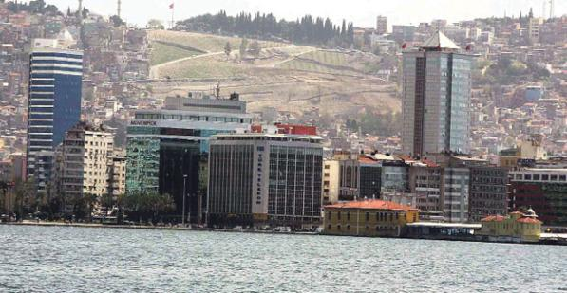
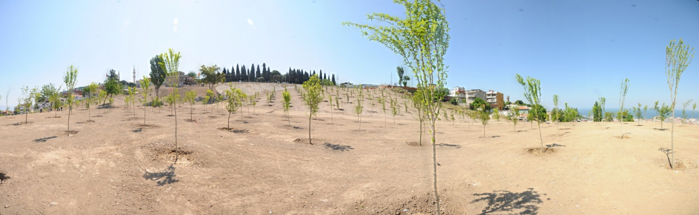
A COMPLETED INNOVATIVE PROJECT: KADIFEKALE
Kentsel Dönüşüm Dairesi Başkanlığı
OUTPUTS:
Safety (before any disaster)
Visibility of Kadifekale
(the famous historical castle)
420.000 m2 green field
SINCE ALL NECESSARY FUNDING HAS BEEN PROVIDED FROM
OWN RESOURCES OF IMM, IT IS AN INNOVATIVE PROCESS.

Slide 11
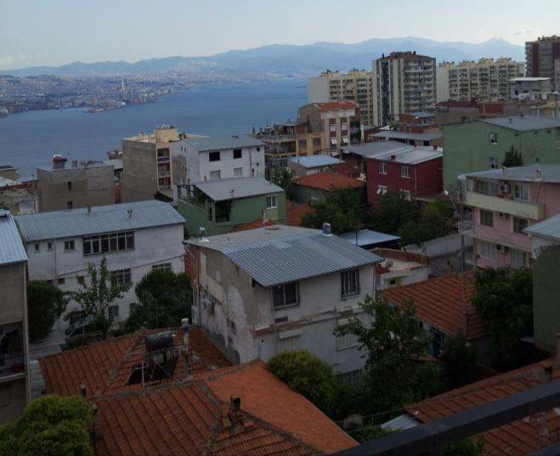
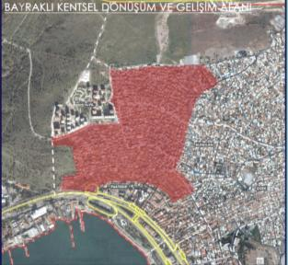
AN ONGOING INNOVATIVE PROJECT – BAYRAKLI
Kentsel Dönüşüm Dairesi Başkanlığı
Project size : 60 ha
Number of parcel : 2037
Private property : 415.603,14 m²
Functions | ADET
House | 5508
Trade | 318
School | 3
Mosque | 3
Construction site | 380
Transformer | 3
TOTAL | 6.215

Slide 12
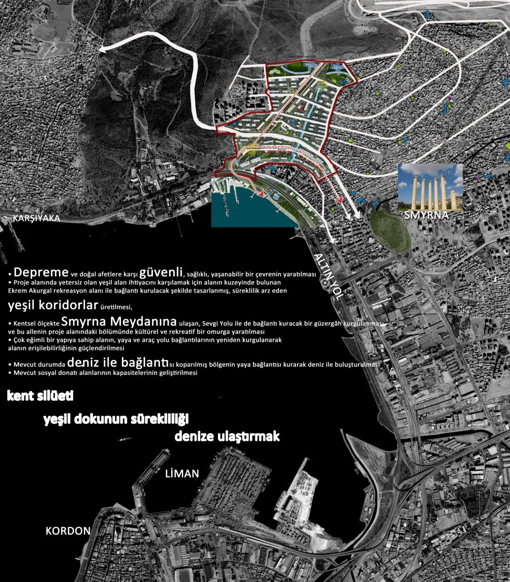
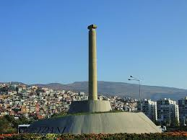
AN ONGOING INNOVATIVE PROJECT – BAYRAKLI
Kentsel Dönüşüm Dairesi Başkanlığı
OBJECTIVES
Much safer buildings
To increase the green field via green corridors reaching Ekrem Akurgal recreation area.
To improve the connection to Smyrna Square (a famous historical location with 6.000 years age),
Better tranportation facilities
Easy access to Izmir Bay
Better social & culturel facilities

Slide 13
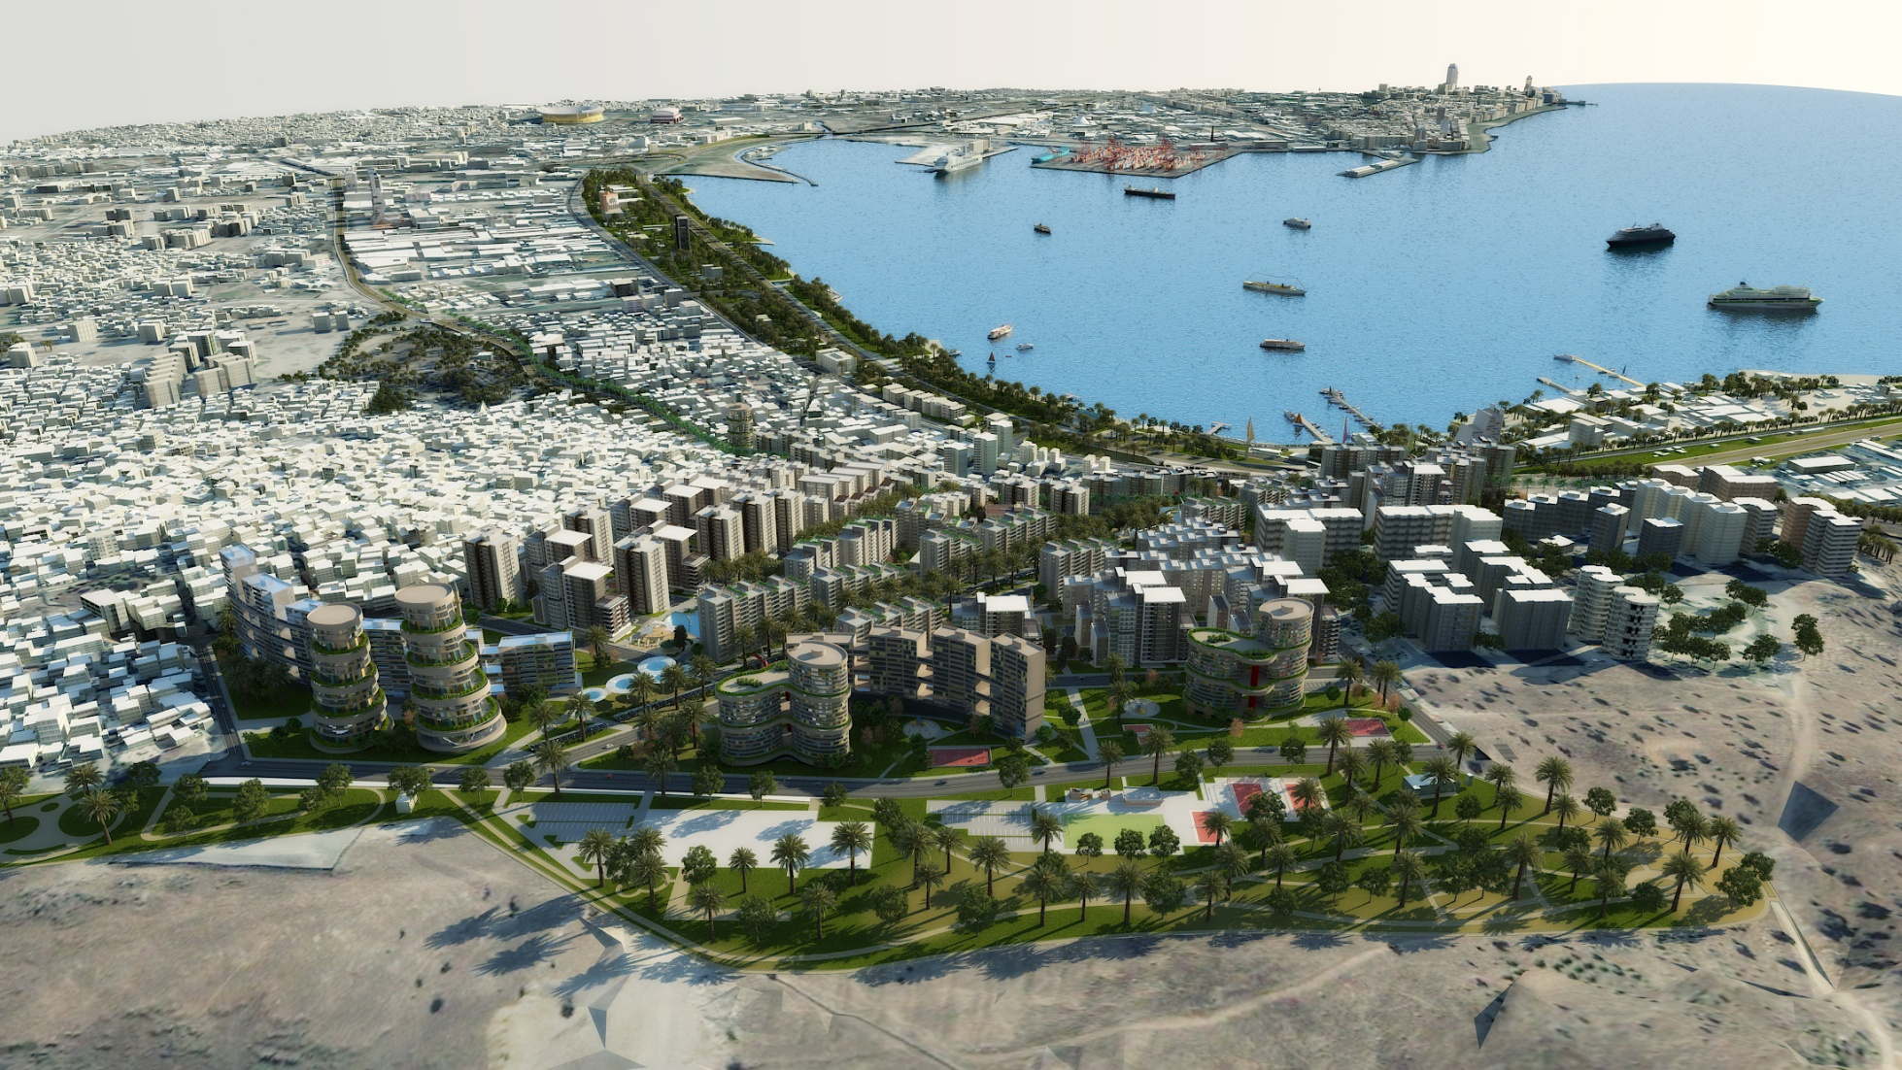
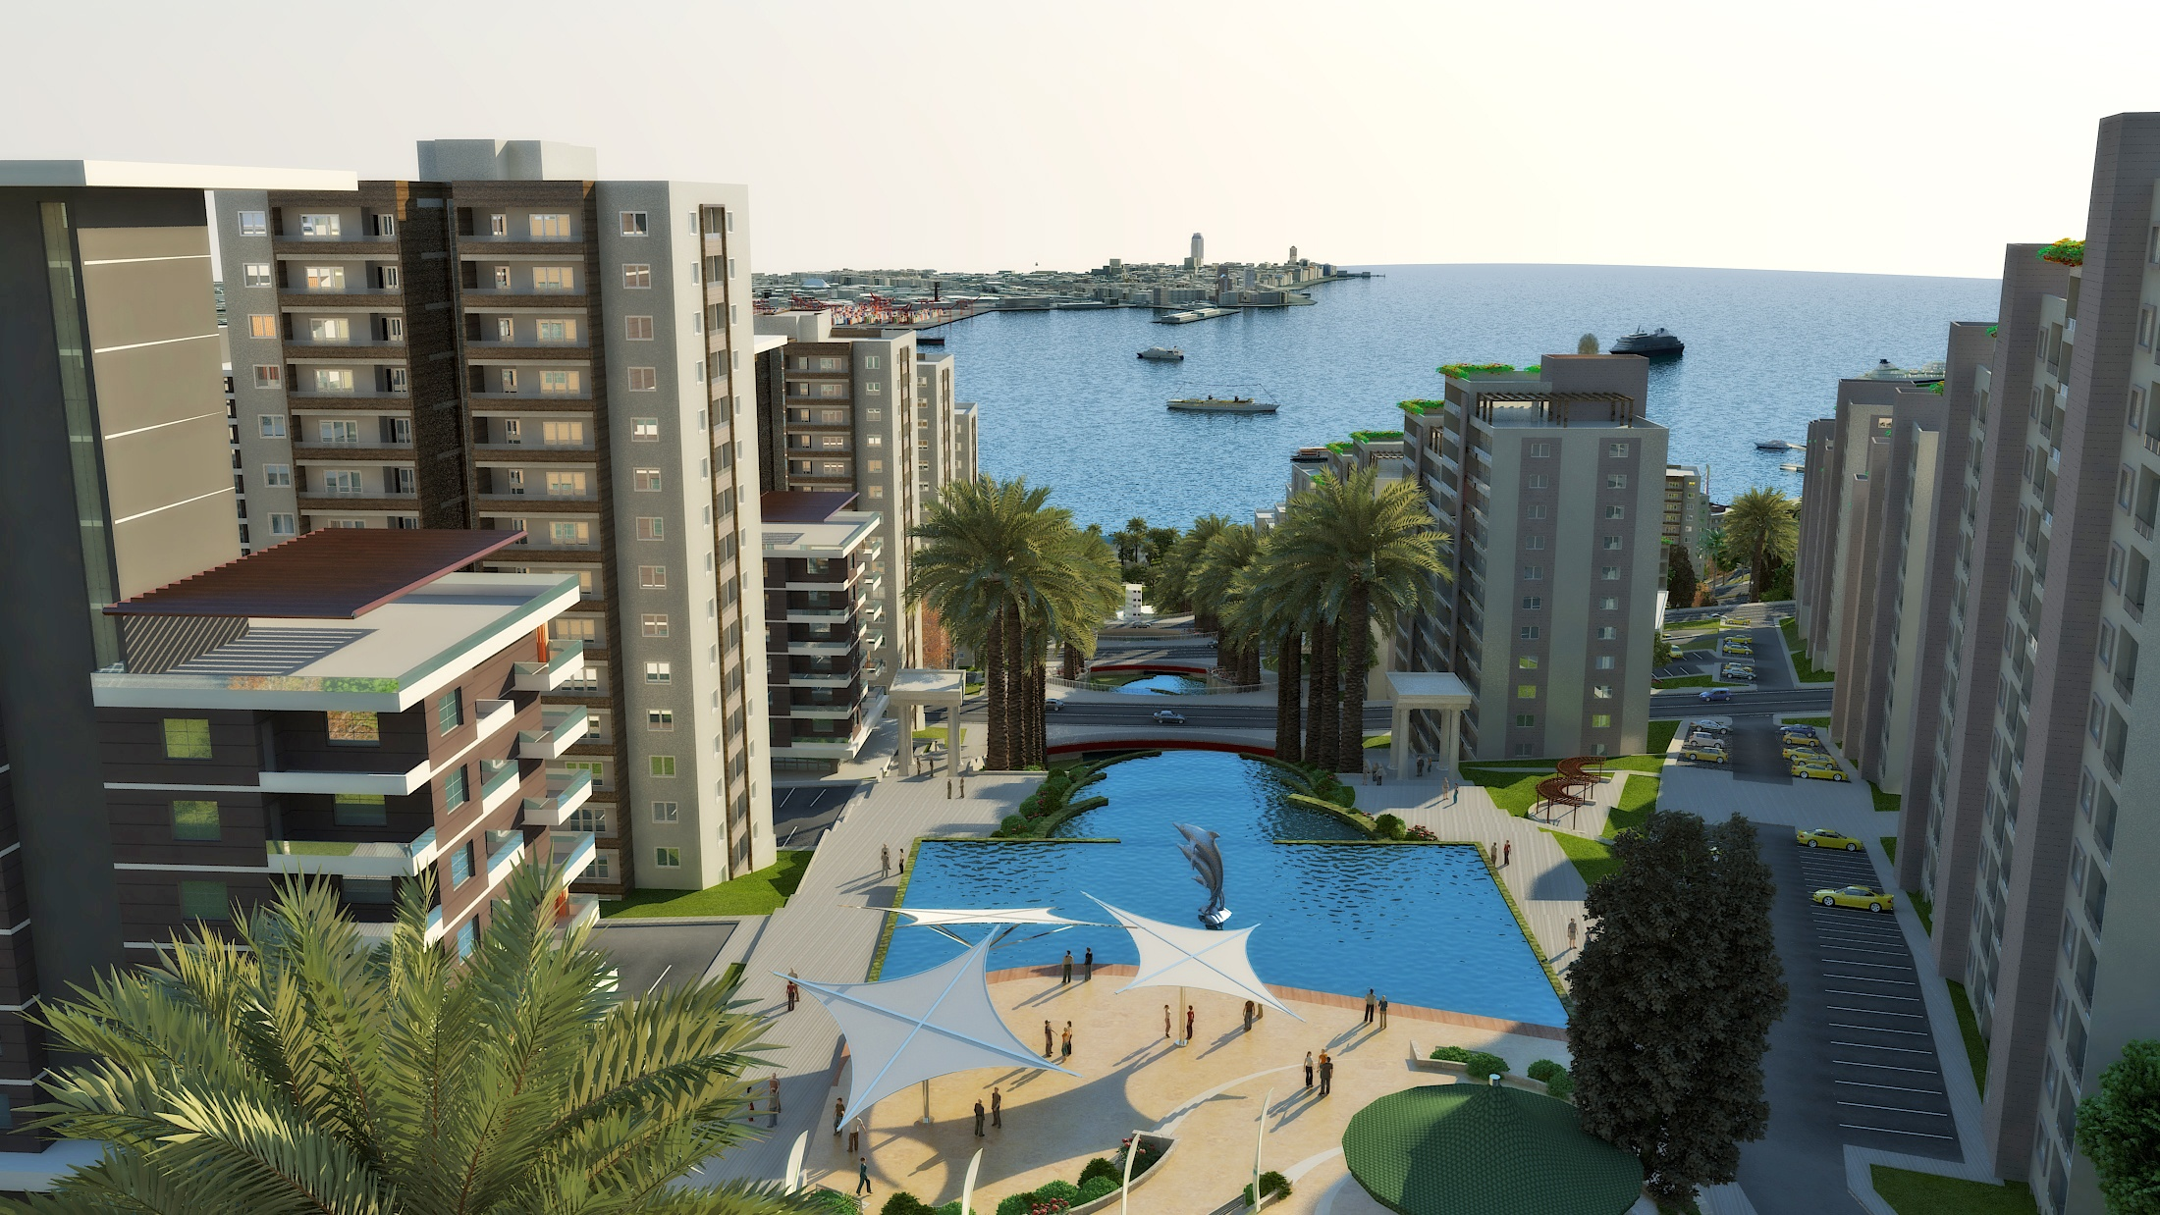
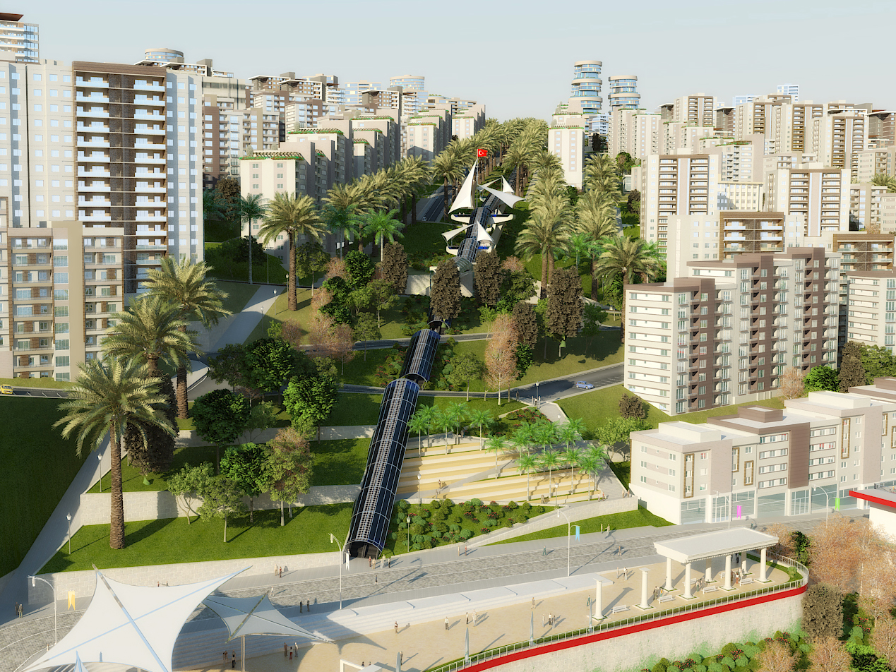
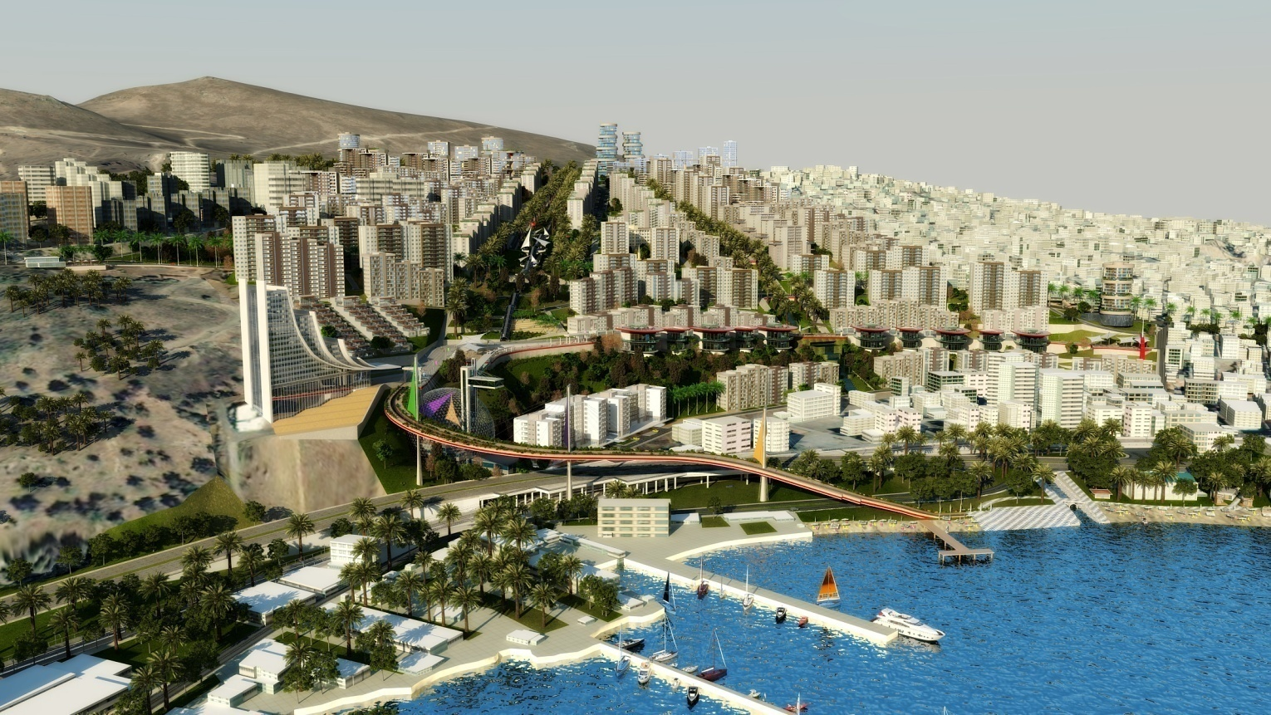
AN ONGOING INNOVATIVE PROJECT – BAYRAKLI
Kentsel Dönüşüm Dairesi Başkanlığı
Urban Design Works Based on Recent Zonning Plans

Slide 14
AN ONGOING INNOVATIVE PROJECT – BAYRAKLI
Kentsel Dönüşüm Dairesi Başkanlığı
WALKING ROADS OPERATING WITH
RENEWABLE ENERGY (SUN & WIND)
INTEGRATION WITH
IZMIRDENIZ PROJECT
Architectural Design

Slide 15
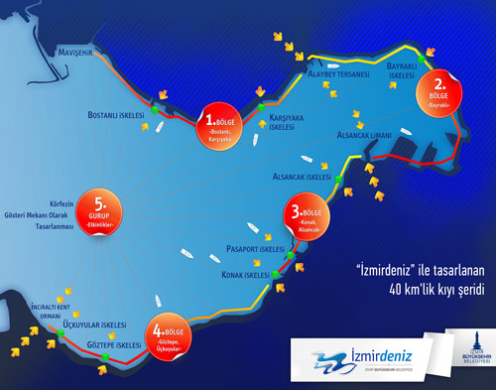
WHAT IS IZMIRDENIZ PROJECT?
İzmirDeniz is an «Innovative Coastal Development Project» aiming to present all the facilities of a coastal city to her citizens including to swim everywhere in the Izmir Bay.
İzmir, iki büyük proje ile yeniden deniz kenti kimliğine kavuşuyor. Körfez'i yüzülebilecek kadar temiz hale getirmek için başlatılan "Büyük Körfez Projesi" ve Körfezi kıyılarıyla birlikte ele alıp bir bütün olarak tasarlamayı hedefleyen İzmirdeniz Projesi eş zamanlı olarak ilerliyor.
İzmirliler'in Denizle İlişkisi Güçlendirme Projesi olarak hazırlanan ve bundan böyle “İzmirdeniz” olarak anılan proje ile; kentin en önemli kamusal alanlarından olan kıyı şeridi yenilikçi bir anlayışla tasarlanacak; İzmirlilerin yaşam kalitesi korunarak arttırılacak; İzmir'in Akdeniz kentleri arasında tasarım temasıyla öne çıkması sağlanacaktır.

Slide 16
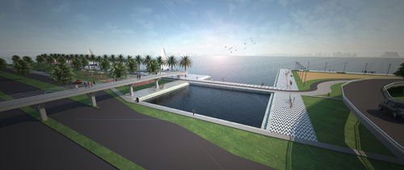
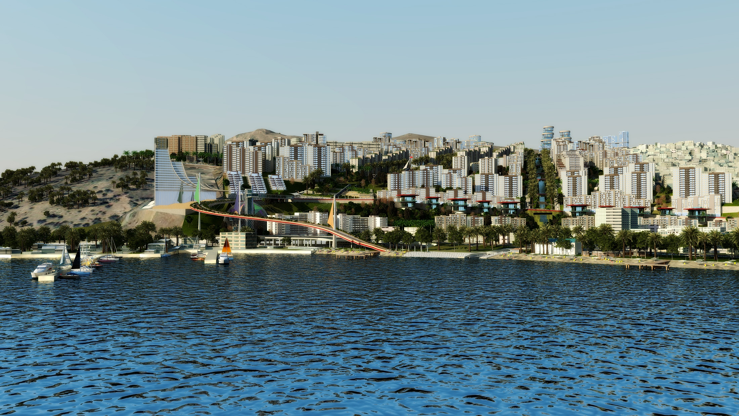
WHAT IS IZMIRDENIZ PROJECT?
Bayraklı
Alaybey Tersanesi - Alsancak Limanı arası, kentin stratejik yönden en önemli bölümlerden biri olarak gelecekte İzmir kentinin merkez fonksiyonlarını yüklenecek. Kent tarihi açısından da oldukça önemli olan antik Smyrna yerleşmesi bu bölgede bulunuyor.
Planlama kararları açısından Turan bölgesinde turizme dayalı kullanımlar, Salhane'de kamu binaları, merkezi iş alanları, alışveriş ve eğlence tesisleri, liman gerisinde ise turizm ticaret alanı ve özel planlama alanları yer alıyor.
Bu bölge, kentin yeni ve dünyaya açık iş merkezi olarak gelişecek. Kurvaziyer limanının bu bölgede yapılacak olması kıyıya ayrı bir kimlik verecek. Tasarım çalışmaları da bu veriler ışığında geliştirildi.

Slide 17
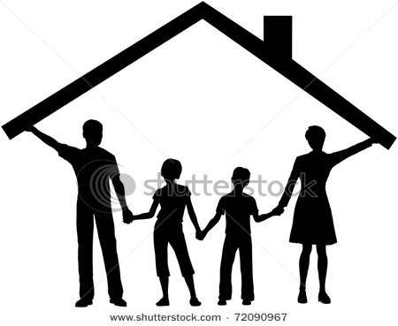
OUR INNOVATIVE UNDERSTANDINGS – WHAT ?
Urban Transformation
should improve
not only the buildings;
but also the life conditions
continuing within these houses.
Therefore, we should have a common target towards URBAN & SOCIAL TRANSFORMATIONS.

Slide 18
OUR INNOVATIVE UNDERSTANDINGS – WHAT ?
Ontime sharing of reliable information,
Public participation to the project,
Determine the views, expectations and requirements of the people,
Inform women & children & disadvadaged people (who will be
the most affected groups) in a detailed manner on the facilities after the transformation,
Improve the social infrastucture through the activities aiming the development of the exconomy and the society
via
COMMUNICATION & COMMUNITY CENTERS

Slide 19
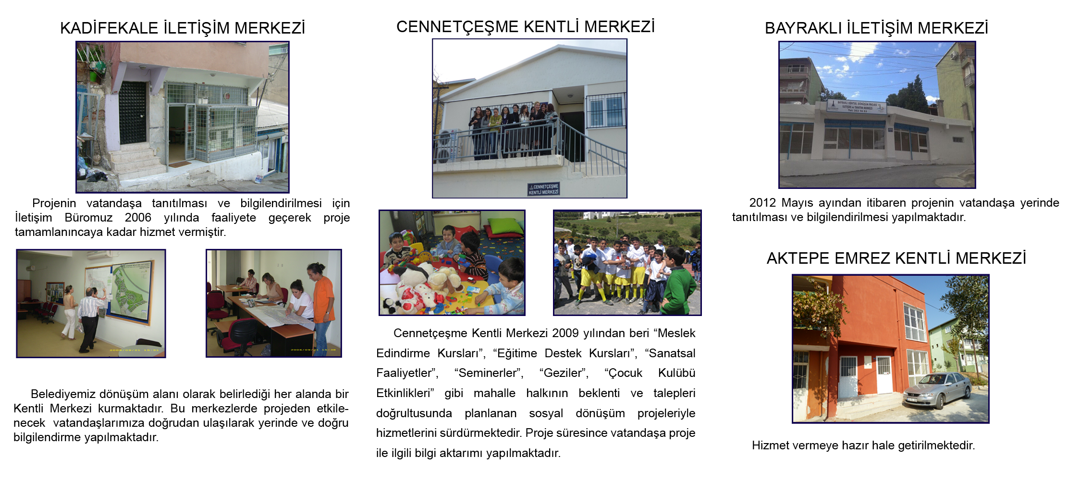
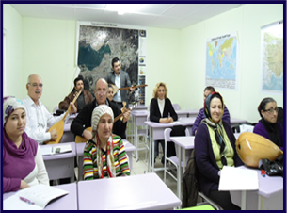
COMMUNICATION CENTERS (During the project)
THE MAIN FUNCTION OF THESE CENTER IS TO INFORM PEOPLE LIVING
IN THE AREA ON ANY ISSUE THEY REQUEST TO LEARN.

Slide 20
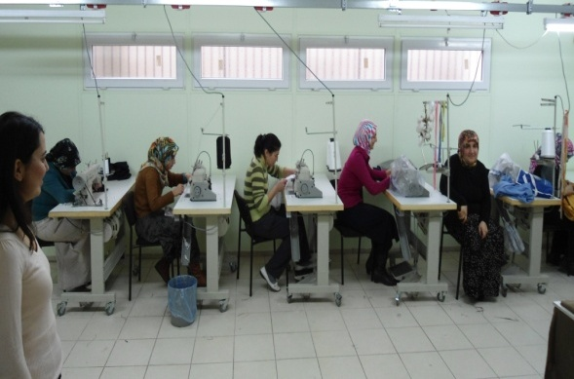
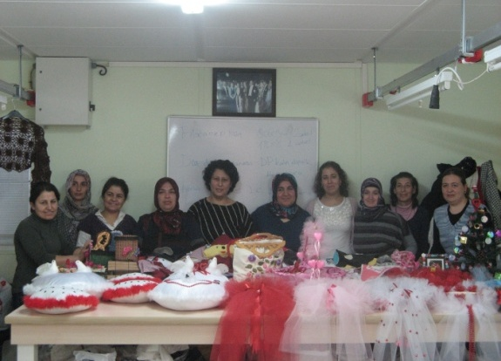
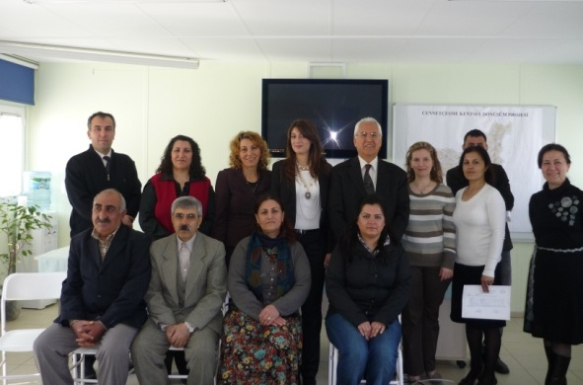
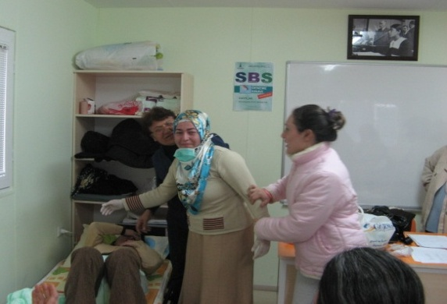
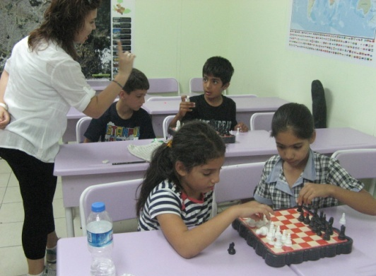
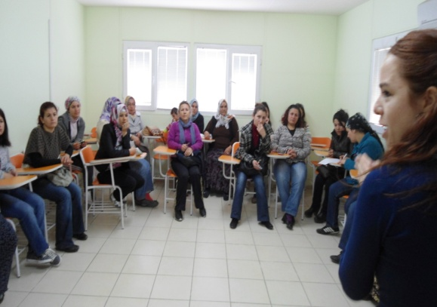
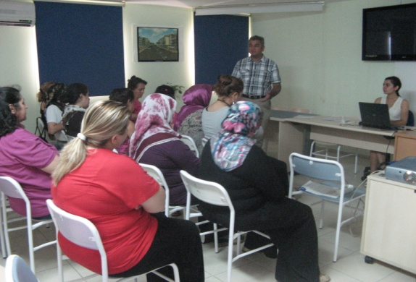
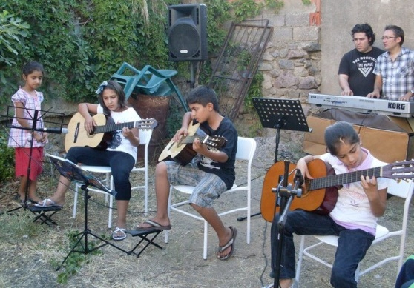
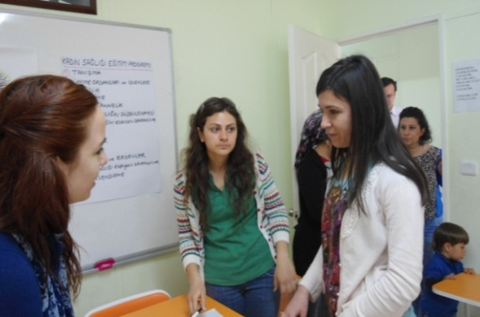
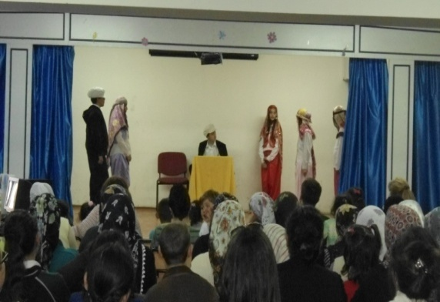
MERKEZLERDE YÜRÜTÜLEN FAALİYETLER
COMMUNICATION CENTERS (During the project)
Continuation traning
Health projects
Personal improvement
Supportive education
Socio-cultural progress
Children club(s)
ACTIVITIES
Konfeksiyon Kursu
Kermes
Sertifika Töreni
Hasta, Yaşlı Bakım Kursu
Satranç Kulübü
Madde Bağımlılığı Semineri
İngilizce Kursu
Müzik Atölyesi Konseri
Kadın Sağlığı Semineri
Tiyatro Kulübü

Slide 21
COMMUNITY CENTERS (Output of the project)
OBJECTIVE
To provide a modern social & cultural environment for the people living in the transformed zone
FACILITIES
i) Sport fields for the children,
ii) Fitness center,
iii) Play grounds for pre-school children,
iv) Activities for mothers, library, internet access & hobby courses
i) Phycological consultancy
YEREL YÖNETİMLER İÇİN ROL MODEL:
YAŞAM MERKEZLERİ

Slide 22
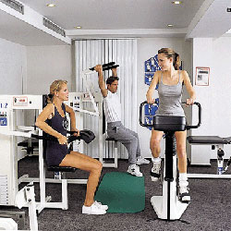
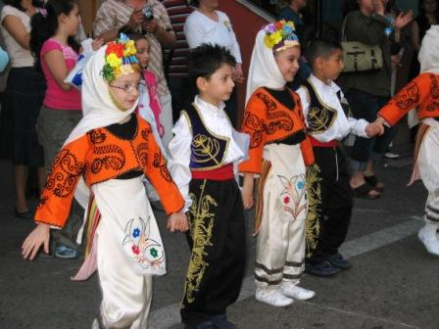
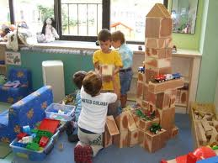
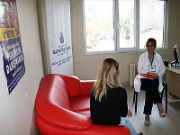
COMMUNITY CENTERS (Output of the project)

Slide 23
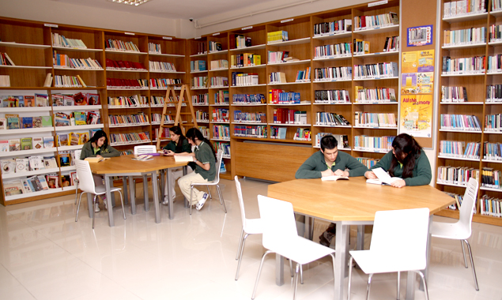
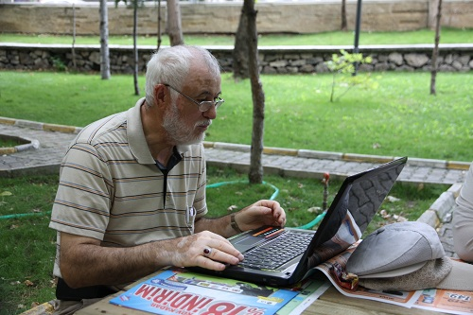
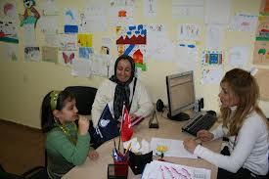
COMMUNITY CENTERS (Output of the project)
Community centers will also be a floor to contact with the municipalities and to learn what they are doing?

Slide 24
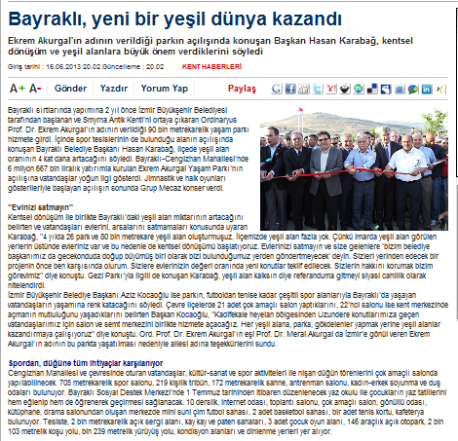
FIRST EXAMPLE – BAYRAKLI COMMUNITY CENTER
90.000 M2 NATURAL PARK INCLUDING SOCIAL, CULTURAL & SPORT FACILITIES (MEETING HALLS; LIBRARY, INTERNET; SOCCER AND BASKETBALL FIELDS; TENNIS COURTS; CAFES ETC.
OUR OBJECTIVE IS TO PROVIDE FACILITIES SIMILAR TO WHEALTY PEOPLE LIVING IN MODERN HOUSING COMPLEXES TO THE CITIZENS OF TRANSFORMED ZONES ☺

Slide 25

RED FLAG: AN INNOVATIVE PROCESS
FOR ACCESSIBLE IZMIR
…AFTER A CHECKING PROCESS BY EXPERT GROUPS AND APPROVAL OF THEIR DECISION BY CITY COUNCIL, AFTERWARDS.
ACCORDING TO OUR «STRATEGIC PLAN FOR ACCESSIBLE IZMIR», TRANSFORMATION ZONES WILL BE GIVEN PRIORITY TO ACHIEVE IDEAL LIVING CONDITIONS FOR EVERYBODY ☺
RED FLAG IS GIVEN TO THE «BUILDINGS & REGIONS» HAVING
NO BARRIER FOR DISADVANTAGED PEOPLE (DISABLED, ELDERLY)…

Slide 26
INNOVATIVE DEFINITION OF URBAN TRANSFORMATION
‘’Urban Transformation’’ is a value creating process.
Therefore, how you are going to share the added value is vitally important.
STAKEHOLDERS:
Family having a property (transferring all their rights to IMM via a contract signed with IMM after agreement)
Society living in the area (who will continue to remain there)
Contractor (being responsible directly to IMM)
SHARING:
Legality (laws, regulations etc.)
Authorities (Ministry, Municipality)
Lawmakers (Government and Turkish Natioal Assembly)
IMM, as being a social democrat municipality:
1) effectively control expences to reduce the cost of the project,
2) share the added value as fair as possible among all stakeholders.

Slide 27
HOW WILL WE REACH OUR TARGETS?
According to recent zonning plans, there is an excess capacity in building stock (more construction rights than existing houses).
We will use this excess capacity to build new houses and sell them
to newcomers from retail price to make a profit (income from sales – payment to contractor = surplus).
We will deliver new houses to property owner without any profit and compansate the contractor’s share via created surplus.
If necessary, we will increase surplus through our own resources.
Property owners will pay/or to be paid due the difference between the non-profit price of their new house(s) and the mutually agreed value of their property (land, house, tree, view advantage, etc).
If any difficulty occurs in making this extra payment, we will supply
/assist for credits with achievable personel payment schedules.

Slide 28
CONCLUSION
THE RECENT TREND IN THE WORLD IS TO CREAT SMART CITIES
TO ACHIEVE BETTER LIVING STANDARDS FOR THE PEOPLE.
THE PRE-REQUEST OF BEING A SMART CITY IS SMART CITIZENS.
ONE – USUALLY - CAN NOT BE SMART IF HIS/HER BASIC DEMANDS (FOOD, HOUSING, HEALTH, EDUCATION ETC.)
CAN NOT BE SATISFIED, PROPERLY.
THIS IS WHY WE CONSIDER «URBAN TRANSFORMATION»
AS A MUST FOR BEING A SMART CITY.
OUR TARGET IS TO MAKE PEOPLE MUCH SATISFIED IN THEIR NEW ENVIRONMENT FOR PROVOKING THEM TO BE SMARTER.
WE BELIEVE THAT OUR INNOVATIVE APPROACH IN
«URBAN TRANSFORMATION» WILL SUPPORT US IN OUR WAY
TOWARDS A SMART CITY OF IZMIR BASED ON INNOVATIONS.

Slide 29
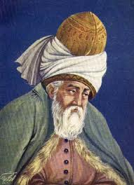
FINAL WORDS FROM HZ. MEVLANA
TopIumsaI bunaIımIarın, kavga ve dövüş ortamının tek ve en güçIü doğuş sebebi sevgi eksikIiğidir. Bunun en doğru tedavi yoIu ise SEVGİYİ aramak, yaşamak, uyguIamaktır. HoşgörüIü oIursanız seversiniz. SeviIirsiniz. Karar verirseniz ve de bu yoIda çaIışırsanız her şeye uIaşırsınız.
THE MOST SIGNIFICANT REASON OF ANY SCALE SOCIAL PROBLEM IS THE LACK OF AFFECTION (LOVE & RESPECT & TOLERENCE).
THE SOLUTION IS: 1) TO SEARCH AFFECTION & 2) TO INTERNALIZE THE AFFECTION & 3) TO PUT AFFECTION INTO PRACTICE.
THIS IS WHY WE ARE HERE AND WHAT WE ARE LOOKING FOR.

Slide 30
UCLG-MEWA Executive Bureau and Council Joint Meeting, in Konya, Turkey
INNOVATIVE PRACTICES
IN
THE CITY OF IZMIR – TURKEY
PROF.DR. ADNAN O. AKYARLI
DEPUTY CHAIRMAN OF
IZMIR METROPOLITAN CITY COUNCIL &
REPRESANTATIVE OF MR. AZİZ KOCAOĞLU
MAYOR OF IMM & CO-PRESIDENT OF UCLG-MEWA
19-20 DECEMBER 2013

